Slide 1
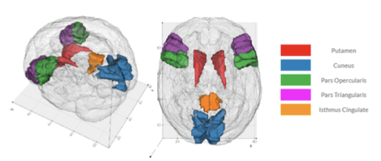
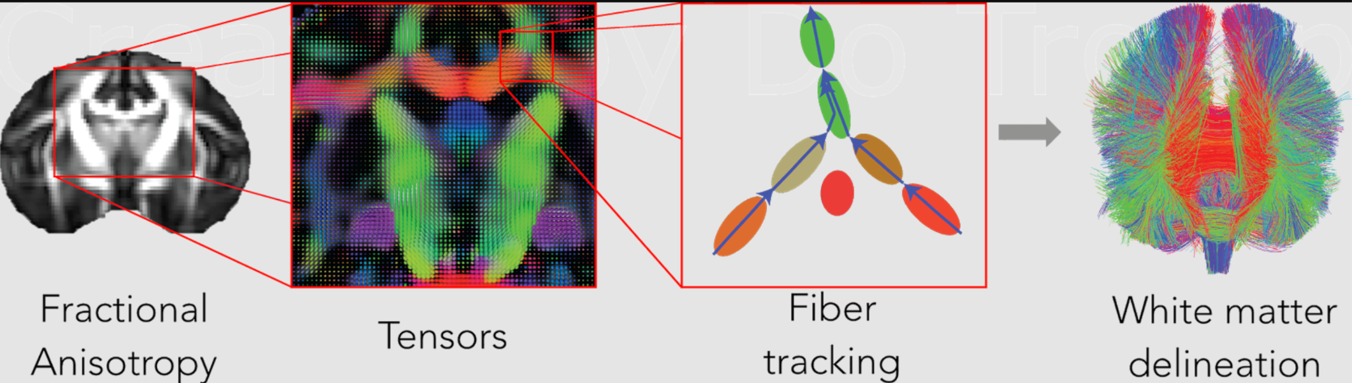
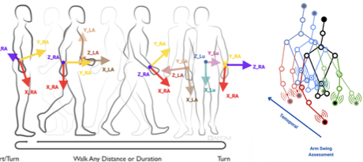
Actionably Intelligent Differential Diagnosis of the Prevalent Mechanisms of Neurological Disorder of Parkinson’s Patients,
for Individualized Intervention and Treatment of Parkinson's Disease
Chandrajit Bajaj
with Aaron Dominick, Ashwin Vinod, Aditya Sai, Jasmin Khalil, Priyanshi Kedia, Ojas Phirke, Thribhuvan Rapolu, Aditya Rajnanarayan, Harsh Trilekhar
Department of Computer Science,
Center for Computational Visualization,
Oden Institute for Computational Engineering and Sciences

Slide 2
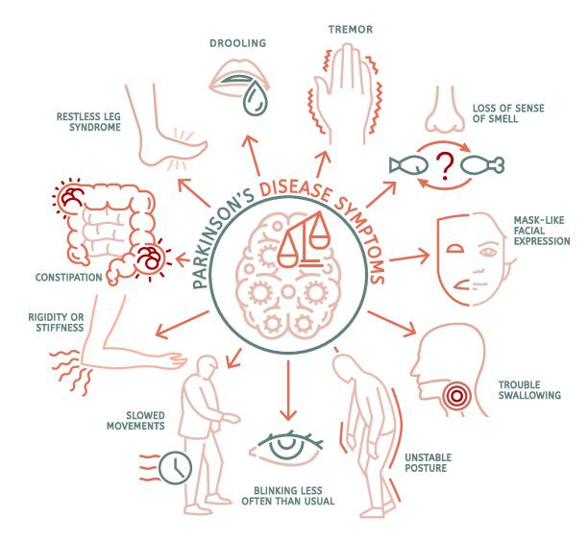
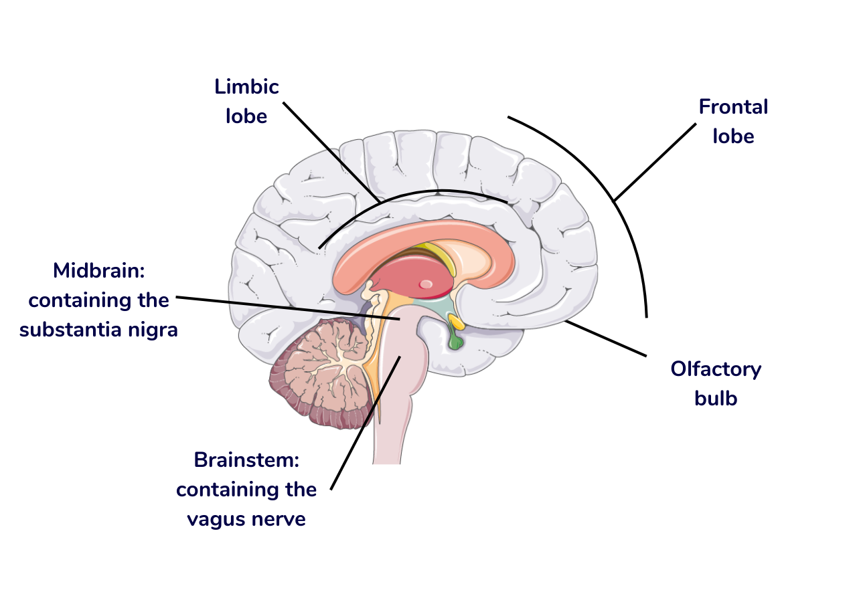
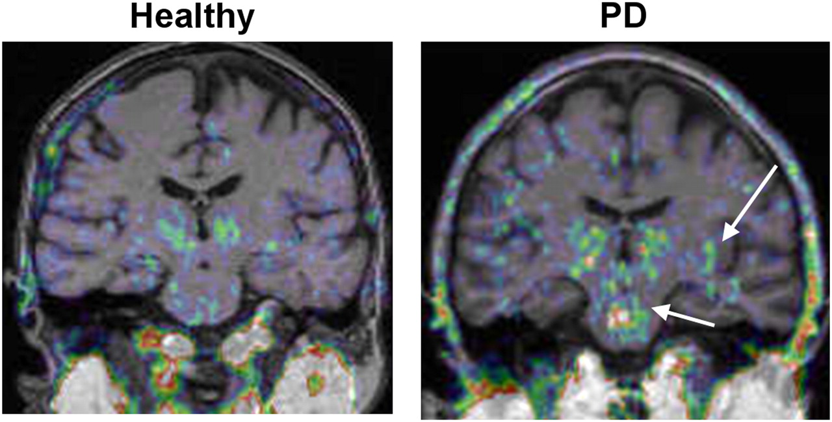
What are typical Parkinson's Disease (PD) Patient Symptoms?
PD is a multisystem α‑synucleinopathy (group of neurological disorders) driven by intertwined protein‑handling, mitochondrial, inflammatory and network factors—not just dopamine alone.
Who all are Affected?
Here are some rough estimates (people living with Parkinson’s disease):
United States: ≈ 1.1 million people. (Parkinson’s Foundation statistics page.) Parkinson's Foundation
India: ≈ 771,000 people in 2019 (95% uncertainty interval: 635,000–919,000), from the India State‑Level Disease Burden Initiative (Lancet Global Health). PMC
Worldwide: ≈ 11.77 million people in 2021, based on Global Burden of Disease 2021 analyses. PMC
Current therapies are mostly symptomatic; no drug has definitively slowed progression in Phase 3 trials yet.
Core Symptoms
Bradykinesia: Slowness of movement, reduced facial expression
Resting tremor: Shaking, typically in one hand
Rigidity: Muscle stiffness
Postural instability: Imbalance and stooped posture
Causes & Diagnosis
Mostly idiopathic (unknown cause)
Genetics, aging, environmental toxins may contribute
Diagnosis based on clinical history and physical examination
Rule out similar conditions: Essential tremor, PSP, MSA, etc.

Slide 3
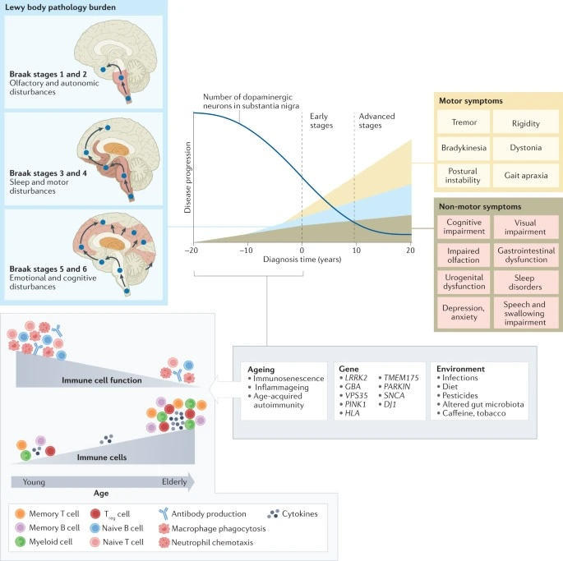
Parkinson disease (PD) affects multiple neurobiological sub-systems, and patients commonly present with accompanying non-motor symptoms, which often start in the prodromal phase.
Prodromal PD is supported by the Braak theory (blue box), in which Lewy body pathologies begin in the periphery and olfactory bulb and advance to the brainstem and towards higher brain centers following a predictable caudal-rostral pattern
When neuronal dysfunction begins, a combination of factors, from an ageing immune system, genes and environment, can create the perfect storm to enable the development and progression of PD pathogenesis
Tansey, M.G., Wallings, R.L., Houser, M.C. et al. Inflammation and immune dysfunction in Parkinson disease. Nat Rev Immunol 22, 657–673 (2022).
https://www.nature.com/articles/s41577-022-00684-6/
A decline in naive T cells and B cells and memory cell accumulation and a reduction in T cell receptor and B cell receptor diversity and sensitivity to stimuli, contribute to an increase in susceptibility to infection and the increased risk of developing PD
Notes:
Although primarily considered a motor-related disorder, Parkinso n disease (PD) affects multiple systems, and patients commonly present with accompanying non-motor symptoms, which often start in the prodromal phase. The concept of prodromal PD is supported by the Braak theory (blue box), in which Lewy body pathologies begin in the periphery and olfactory bulb and advance to the brainstem and towards higher brain centres following a predictable caudal-rostral pattern204. During the prodromal stage, when neuronal dysfunction begins, a combination of factors, from an ageing immune system, genes and environment, can create the perfect storm to enable the development and progression of PD pathogenesis. Age-associated alterations in the immune system include immunosenescence and inflammageing as well as an impaired adaptive immune system defined by a decline in naive T cells and B cells and memory cell accumulation and a reduction in T cell receptor and B cell receptor diversity and sensitivity to stimuli13,14,15. These deficiencies contribute to an increase in susceptibility to infection and a type of age-acquired autoimmunity where autoantibodies may begin to appear. There are now multiple lines of evidence that suggest a relationship between environmental stressors, including viral and bacterial exposures, pesticides, diet, and alterations in gut microbiota, and the increased risk of developing PD. Treg cell, regulatory T cell.
Bradykinesia in Parkinson's disease refers to the slowness of movement that is a hallmark symptom of the condition. It's characterized by a reduced speed and amplitude of movement, particularly when performing repetitive actions.

Slide 4
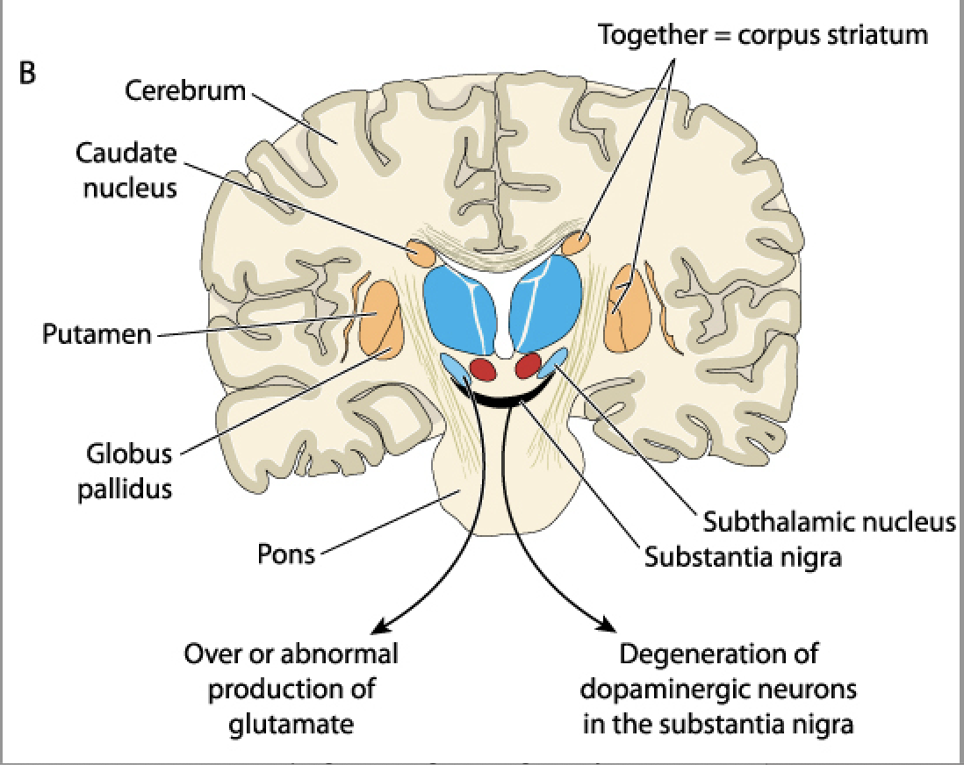
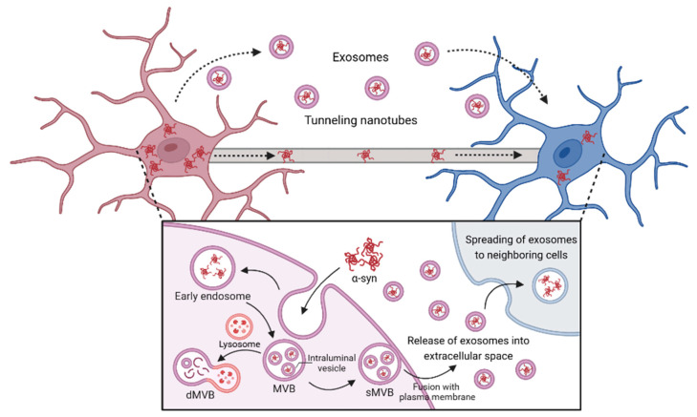
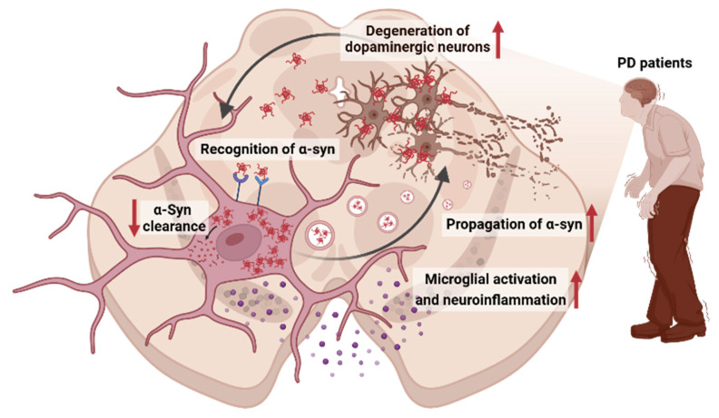
Core NeuroBiology (what causes PD at the Neuronal Cellular/Circuit level) -1
A. Misfolded α‑synuclein and Lewy pathology. In most PD, α‑synuclein misfolds, aggregates (Lewy bodies/neurites), and appears to spread along connected neural networks; this process activates microglia and other immune pathways that may further damage neurons. PMCNature
B. Failed cellular housekeeping (lysosome–autophagy) and mitochondria. Defects in lysosomal enzymes/trafficking (e.g., GBA1) and mitochondrial quality control (e.g., PINK1/PRKN) impair protein clearance and energy production, stressing dopamine neurons in the substantia nigra. (These mechanisms are major themes across modern PD genetics and pathology reviews.) Nature
Notes:
A schematic that illustrates the key interaction mechanisms between microglia and α-syn in PD:
Bidirectional interaction between α-syn and microglia. Microglia recognize α-syn aggregates through surface receptors, leading to their internalization. Once inside microglia, impaired clearance mechanisms may result in the accumulation of α-syn, which can then be released, facilitating the propagation of pathological aggregates to neighboring cells. The internalized α-syn triggers microglial activation, resulting in the production and release of pro-inflammatory cytokines, contributing to neuroinflammation. The persistent inflammatory response, alongside the spread of α-syn aggregates, ultimately leads to the degeneration of dopaminergic neurons, a hallmark of PD progression.
α-Syn propagation to neighboring cells by TNTs and exosomes of microglia. Microglia internalize extracellular α-syn via endocytosis and form early endosomes. The endosomal membrane then invaginates into its lumen and forms multivesicular bodies (MVBs). These mature MVBs are processed by two pathways: the degrative and secretory pathway. Degrative MVBs (dMVBs) fuse with lysosome, leading to degrade α-syn within MVBs; however, secretory MVBs (sMVBs) are fused with plasma membrane and then released into the extracellular space. Additionally, TNTs directly connect adjacent cells, enabling the transfer of α-syn aggregates across cytoplasmic bridges. Together, exosome-mediated and TNT-driven transport enhance the dissemination of α-syn pathology along neural networks, contributing to disease progression.
The release of exosomes profoundly affects neuronal behavior by acting as messengers, influencing synaptic plasticity, promoting neuronal survival, and modulating gene expression through the transfer of proteins, lipids, and nucleic acids. This intercellular communication is crucial for normal brain function, but altered exosome profiles are also implicated in neurodegenerative diseases like Alzheimer's and Parkinson's, making them potential biomarkers and therapeutic targets. Altered exosome profiles contribute to Parkinson's disease (PD) by spreading the misfolded alpha-synuclein protein from affected neurons to healthy cells, which promotes disease progression and neuroinflammation.

Slide 5
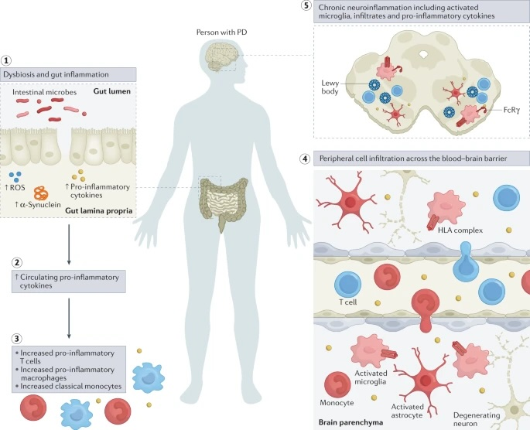
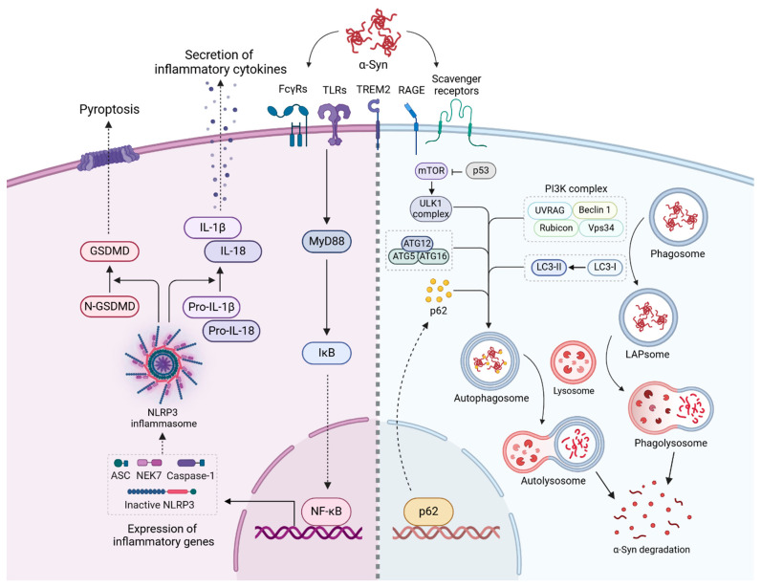
Core NeuroBiology (what causes PD at the Neuronal Cellular/Circuit level) - 2
C. Neuroinflammation (innate + adaptive). Aggregated α‑syn can activate microglia; T‑cells recognizing α‑syn–derived peptides have been detected in PD, suggesting maladaptive immune responses may contribute to progression.
D. Ion/calcium and oxidative stress vulnerabilities. Nigral dopamine neurons are autonomous pacemakers with high calcium flux and metabolic demand; hypotheses that blocking L‑type channels would slow PD were not confirmed in a large Phase 3 trial (isradipine).
Notes:
Mechanisms of microglial activation and α-syn degradation in PD. This schematic illustrates the intracellular signaling pathways through which microglia respond to α-syn aggregates, encompassing inflammatory activation, phagocytosis, and autophagy. Recognition of α-syn by microglial surface receptors activates MyD88, leading to the degradation of IκB and activation of NF-κB, which promotes inflammatory gene transcription. In parallel, the NLRP3 inflammasome becomes activated, assembling components such as ASC, NEK7, and caspase-1. Caspase-1 processes pro-IL-1β and pro-IL-18 into their mature, secreted forms (IL-1β and IL-18), further driving the inflammatory response. Activated GSDMD forms membrane pores, inducing pyroptotic cell death, a process implicated in chronic neuroinflammation and neurodegeneration in PD. Microglia degrade α-syn aggregates through phagocytosis and autophagy pathways. α-Syn internalized into phagosomes can undergo LAP, facilitated by the PI3K complex (UVRAG, Beclin-1, Rubicon, Vps34) to form phagolysosome α-syn degradation. Concurrently, the autophagy pathway, regulated by the ULK1 complex and modulated by mTOR and p53, encapsulates α-syn in autophagosomes. These autophagosomes fuse with lysosomes to form autolysosomes, where α-syn is degraded. The LC3 conjugation system (ATG5, ATG12, ATG16) and p62 serve as key components for cargo recognition and delivery.
The figure highlights inflammatory manifestations that have been identified in patients with Parkinson disease (PD). Intestinal dysbiosis and inflammation (step 1), increases in levels of circulating pro-inflammatory cytokines (step 2), innate and adaptive immune cell activation and changes in frequency (step 3), blood–brain barrier permeability and peripheral immune cell infiltration of the central nervous system (step 4) and neuroinflammation (step 5) are hallmarks of a pro-inflammatory immune phenotype in PD. ROS, reactive oxygen species.
In Parkinson's disease (PD), both excess calcium (Ca2+) and oxidative stress contribute to the degeneration of dopaminergic neurons by disrupting cellular processes. Excessive Ca2+ influx from extracellular sources, mediated by channels like NMDA receptors, activates enzymes that produce inflammation and free radicals, a key component of oxidative stress. This stress, coupled with mitochondrial dysfunction and iron accumulation, damages DNA and protein, leading to neuron death.

Slide 6
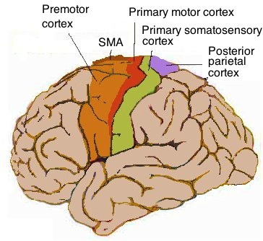
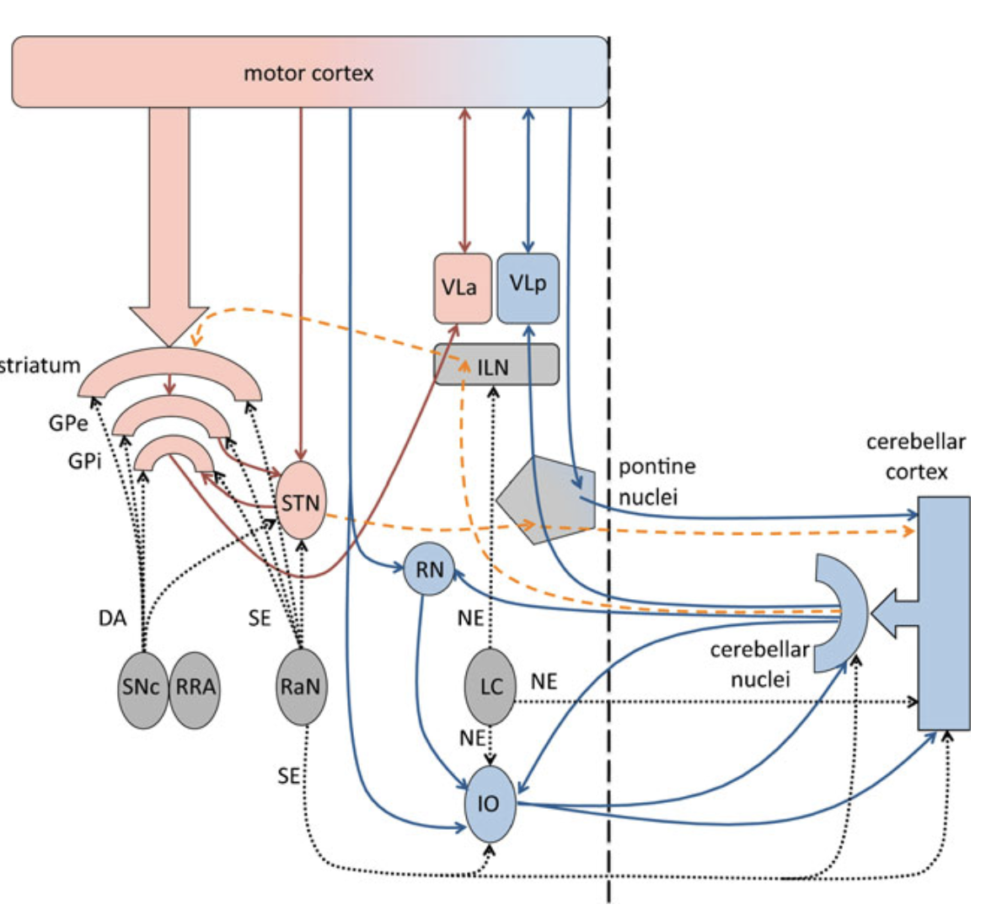
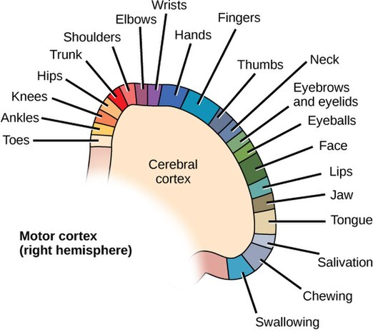
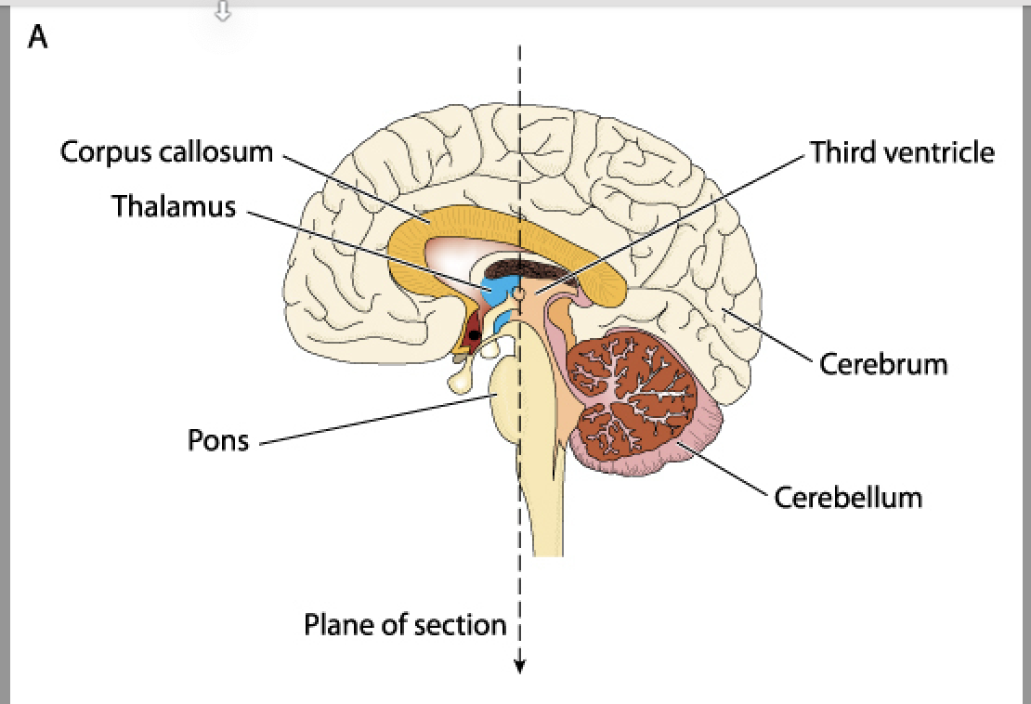
Core NeuroBiology (what causes PD at the Neuronal Cellular/Circuit level) - 3
E. Network/circuit changes beyond dopamine. Motor symptoms reflect both nigrostriatal dopamine loss and changes in cerebello‑thalamo‑cortical and cholinergic systems (the latter especially for gait/posture and cognition). PMCPubMed
Notes:
Changes in the cerebello-thalamo-cortical and cholinergic systems significantly impact gait, posture, and cognition in Parkinson's disease (PD), with cholinergic system dysfunctions being particularly linked to gait and balance problems, like falls and freezing, and cognitive deficits, even independent of dopaminergic damage. Specifically, damage to the cholinergic projections from the basal forebrain to the cortex and from the brainstem's pedunculopontine nucleus (PPN) impairs attention and motor control, leading to difficulty with postural adjustments and gait. The cerebellum's role in integrating sensory and motor information, along with its connections to the basal ganglia, further contributes to posture and gait control, with disruptions in this network also affecting the motor symptoms of PD.
The anatomy of tremor.The basal ganglia and itsconnections are shown in red,
and the cerebellar system and itsconnections are shown in blue.Modulatory neurotransmitterprojections are shown as dottedblack lines. Anatomical
connections between basal
ganglia and the cerebellum are
shown as dashed yellow lines.
DA dopamine, GPi internal part
of the globus pallidus, GPe
external part of the globus
pallidus, ILN thalamic
interlaminar nuclei, IO inferior
olive, LC locus coeruleus, NE
norepinephrine, RaN raphe
nuclei, RN red nucleus, RRA
retrorubral area, SE serotonin,
SNc substantia nigra pars
compacta, STN subthalamic
nucleus, VLa anterior part of the
ventrolateral thalamus, VLp
posterior part of the ventrolateral
thalamus

Slide 7
Typical Interventions to Neuro‑Biological Manifestations - 1
A. Nigrostriatal dopamine deficit → Bradykinesia/Rigidity/Tremor
First‑line dopaminergic options (early PD, motor symptoms): . Levodopa/carbidopa (immediate or extended‑release), dopamine agonists, MAO‑B inhibitors (rasagiline, selegiline; safinamide if already on levodopa and having OFF time). • Rytary® (extended‑release levodopa/carbidopa) — FDA‑approved to smooth motor control. • Safinamide (Xadago®) — add‑on to levodopa to increase “ON” time;
Continuous dopaminergic delivery (advanced PD): Enteral carbidopa/levodopa gel (Duopa®) via PEG‑J tube; continuous subcutaneous levodopa/carbidopa (Vyalev™, 2024); continuous apomorphine infusion (Onapgo™, 2025).
Circuit‑targeting procedures:
Deep Brain Stimulation (DBS) of STN/GPi for motor fluctuations/tremor (established standard).
MR‑guided Focused Ultrasound (FUS) for ablation—initially unilateral, bilateral staged FUS gained FDA clearance in July 2025 (select centers; staged months apart) and can reduce tremor/dyskinesia in advanced PD.

Slide 8
Typical Interventions to Neuro‑Biological Manifestations - 2
B. Tremor circuits (cerebello‑thalamo‑cortical) → medication‑refractory tremor
Try: optimization of levodopa; limited role for anticholinergics in younger patients due to cognitive side effects.
Escalate: DBS (VIM thalamus or STN)
C. Dyskinesia (glutamatergic overactivity + pulsatile dopamine)
Amantadine (especially extended‑release Gocovri®) reduces levodopa‑induced dyskinesia. Dose cautiously for hallucinations, insomnia, livedo reticularis.
Adjust dopaminergics (fractionate levodopa, lower agonists)
D. Gait/postural instability, falls (cholinergic & diffuse network involvement)
Rehab/exercise is foundational (gait/balance training, amplitude‑based therapy, Tai Chi); high‑quality reviews and Cochrane note clinically meaningful benefits in motor function and balance.
Medications offer limited benefit; DBS helps freezing less reliably;
Notes:
Dyskinesia in Parkinson's disease refers to involuntary, uncontrolled, and erratic movements of the face, trunk, or limbs, often described as fidgeting, writhing, or swaying

Slide 9
Typical Interventions to Neuro‑Biological Manifestations - 3
E. Cognition & hallucinations/psychosis (cholinergic + network)
Parkinson’s disease dementia: Rivastigmine (capsule or patch) is FDA‑approved and improves cognition/behavior modestly.
Psychosis: Pimavanserin (Nuplazid®) is FDA‑approved for PD psychosis with minimal motor worsening; quetiapine/clozapine remain off‑label options when needed.
F. Autonomic failure (noradrenergic and peripheral autonomic circuits)
Orthostatic hypotension: fluids/salt/compression first; medications include droxidopa (Northera®) and midodrine; monitor for supine hypertension.
Sialorrhea: botulinum toxin injections into salivary glands have the best evidence for efficacy.
Constipation: start with fiber/fluids; polyethylene glycol (PEG) is a recommended first‑line osmotic laxative; other options per GI guideline
Urinary urgency/overactive bladder: mirabegron or antimuscarinics (balance cognitive side effects; mirabegron often favored for cognition).
Notes:
Dyskinesia in Parkinson's disease refers to involuntary, uncontrolled, and erratic movements of the face, trunk, or limbs, often described as fidgeting, writhing, or swaying

Slide 10
Typical Interventions to Neuro-Biological Manifestations - 4
G. Mood, anxiety, and sleep (monoaminergic systems beyond dopamine)
Depression/anxiety: SSRIs/SNRIs are commonly used and, on average, helpful without worsening motor signs in meta‑analyses; tailor to comorbidities and drug–drug interactions. (Tricyclics may be effective but have more anticholinergic effects.)
REM sleep behavior disorder (RBD): melatonin or clonazepam per 2023 American Academy of Sleep Medicine guideline. Safety counseling (bed environment) is essential.
H. Impulse‑control disorders (ICDs) from dopaminergic stimulation
Often triggered by dopamine agonists; first step is dose reduction or discontinuation (slow tapers), with CBT and multidisciplinary support; expert consensus pathways updated in 2024.
-
Are these Interventions Optimally Individualized to each patient based on past and current neuro-biological manifestations ?
Notes:
Dyskinesia in Parkinson's disease refers to involuntary, uncontrolled, and erratic movements of the face, trunk, or limbs, often described as fidgeting, writhing, or swaying

Slide 11
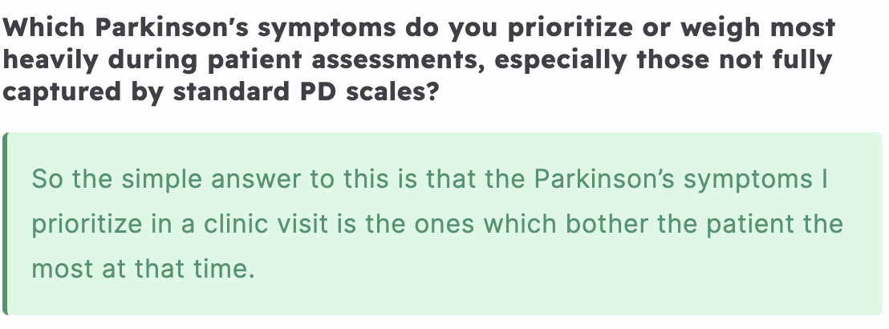


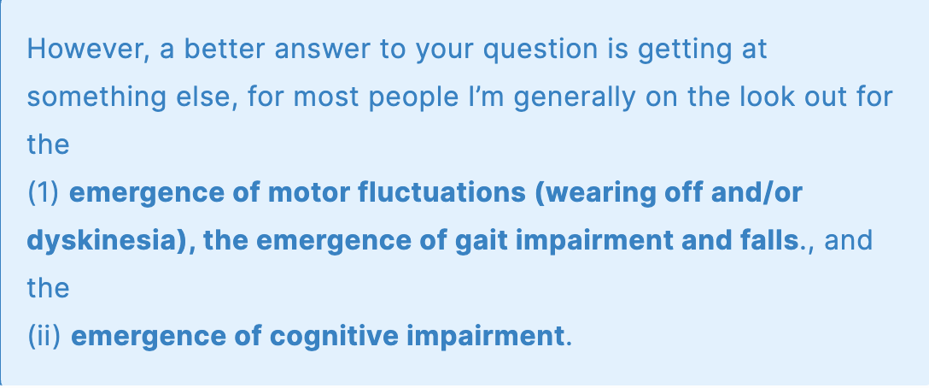
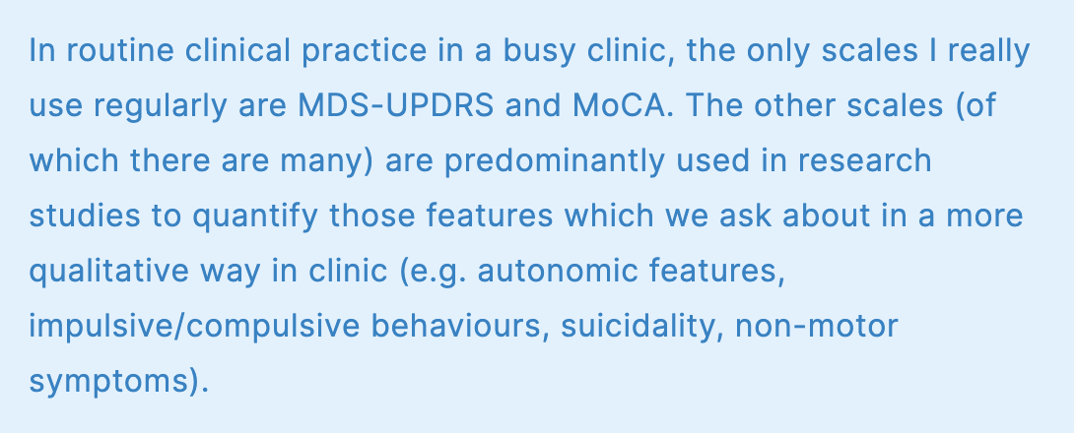
Clinical Q/A with Dr. Conor Fearon (MD, Phd, Neurologist at Mater Misericordiae University Hospital, Dublin, Ireland)

Slide 12
So how can AI/ML help the Patient ?
Progressive (continually active)
Decision Making Agents
that robustly and causally, cross-correlate multi-modal patient data
to differentially diagnose,
and to optimally guide individualized intervention
in the treatment of Parkinson's disease

Slide 13
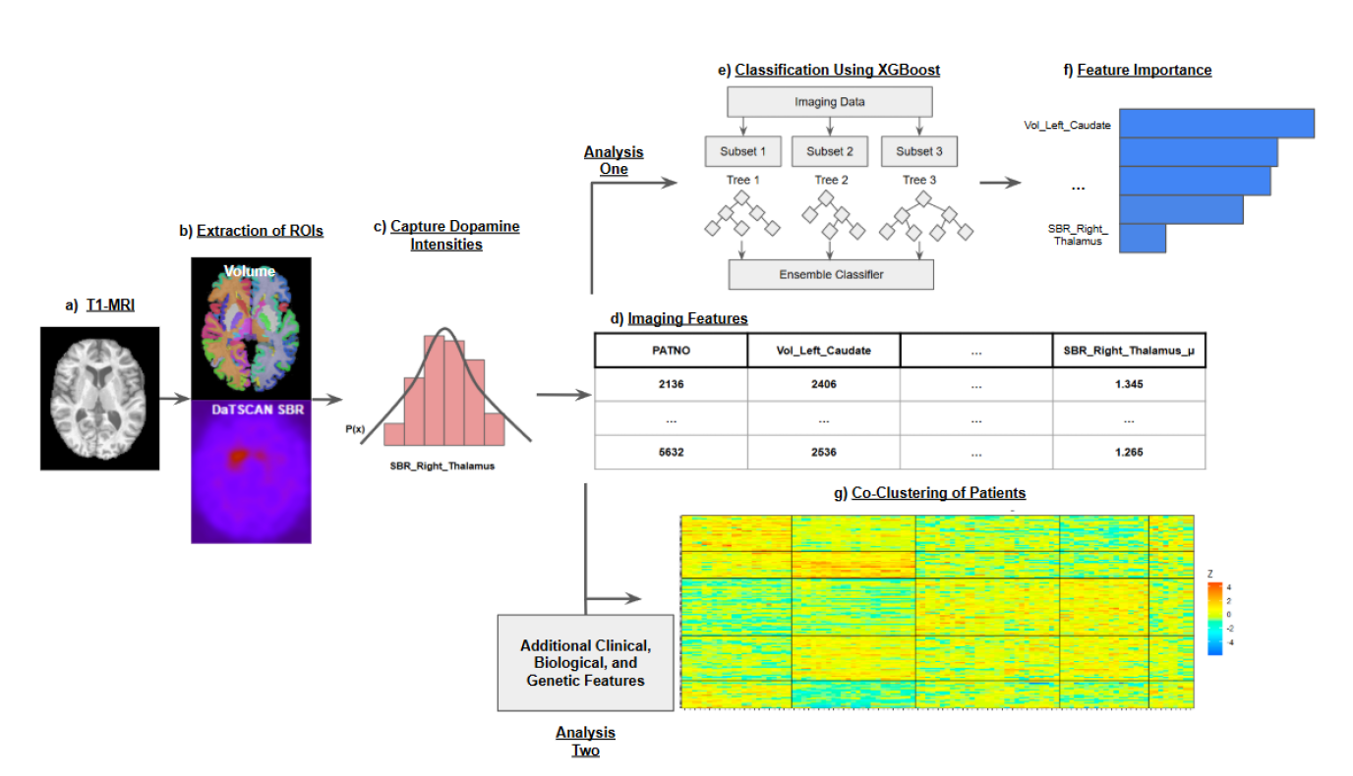
Progressive AI: Continually Active Decision Making Agents Balancing Risk and Reward
Robust Causal and Cross-Correlation of Multi-modal DaT and DTI with Genetic, Clinical, Biological and Gait/Arm Swing Signal Filtered Data
Reinforcement Learning with Stochastic Policy Optimization on Hamiltonian Manifolds
C. Bajaj, C., Nguyen, M. “Physics-Informed Neural Networks via Stochastic Hamiltonian Dynamics Learning. In: Arai, K. (eds) Intelligent Systems and Applications. IntelliSys 2024.LNNS, Springer
M. Nguyen, C.Bajaj “A Differential and Pointwise Control Approach to Reinforcement Learning” ArxiV 2404.15167v3, 2025

Slide 14
So what data is available to today’s AI Progressive Agent ?
Data Modality / Source | Description
Clinical assessments | MDS-UPDRS-III, UPSIT (olfactory), Sleep (Epworth, REM), QUIP, SCOPA-AUT Cognitive tests (Hopkins Verbal, Benton exam, MOCA) , history, medications
Imaging | DaTSCAN, structural MRI, DTI, DKI, NODDI
Laboratory & Genetic | CSF lab measures, DNA, genetic data
Biospecimens | Serum, plasma, urine, CSF, skin biopsies
Remote assessments | Olfactory testing, genetic via Remote protocol
Online self-reports | Portions of MDS-UPDRS collected via web-based app
Telephone follow-ups | Additional clinical follow-up via phone consultations
PPMI (Parkinson’s Progression Markers Initiative) database and more…

Slide 15
So what data is available to today’s AI Progressive Agent ?
Data Modality | Data Type / Tests Collected
Smartphone & Wearable Sensors | Accelerometry, gyroscope, touchscreen, microphone; tests include walking, tremor, daily tasks
Levodopa Response Wearable Study | Accelerometer + smartphone; in-lab motor tasks + home monitoring over 4 days
Handwriting Samples | Kinematic and pressure data during scripted writing tasks (spirals, words, sentences)
Keyboard Dynamics | Keystroke hold times during natural computer use
Genomics (WGS) | Whole-genome sequencing from large PD cohorts
Transcriptomics (RNA-seq) | Gene expression data for molecular profiling
Clinical / Phenotypic Assessments | Standard clinical test scores, demographics, motor and non-motor evaluations
synapse.org Databases for Parkinsons Research

Slide 16
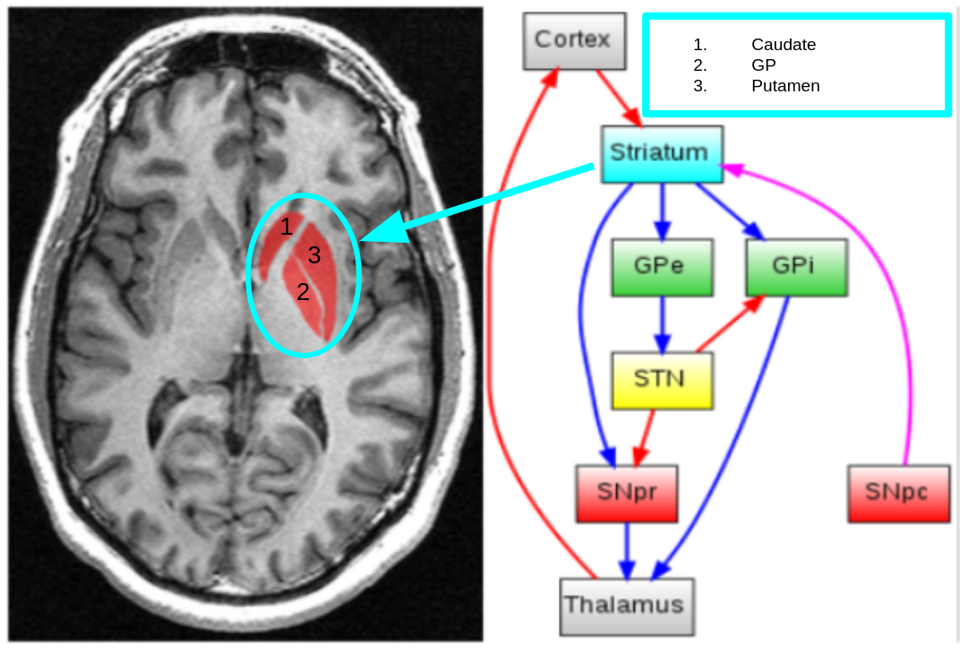
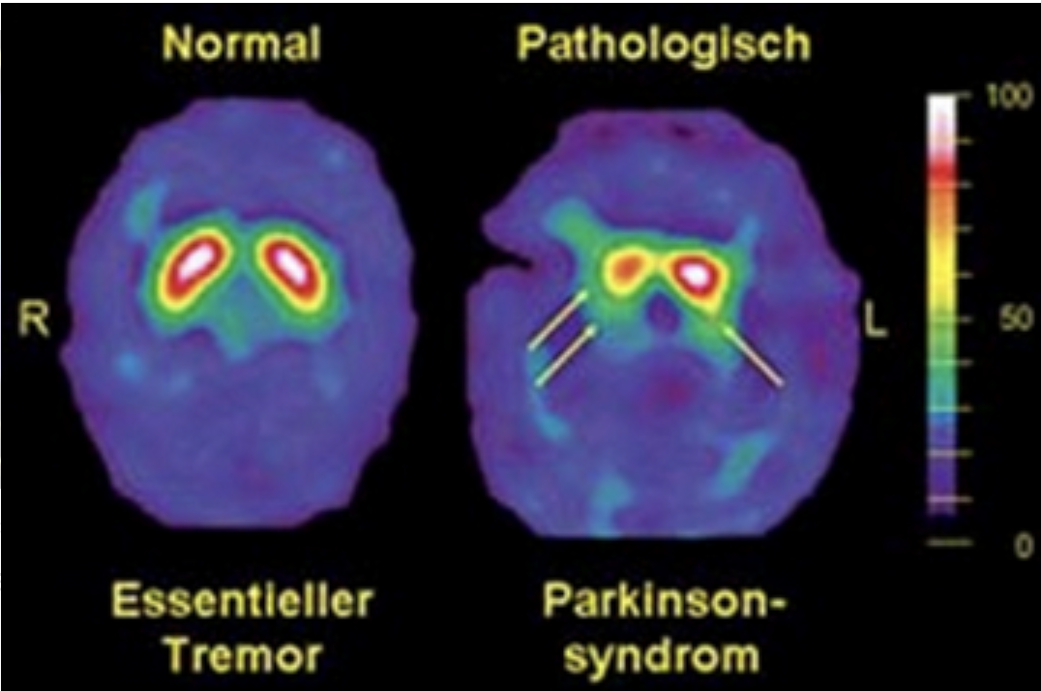
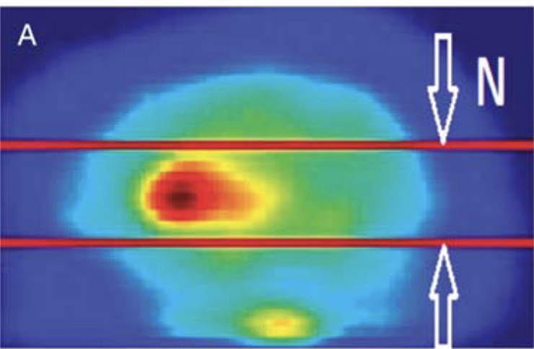
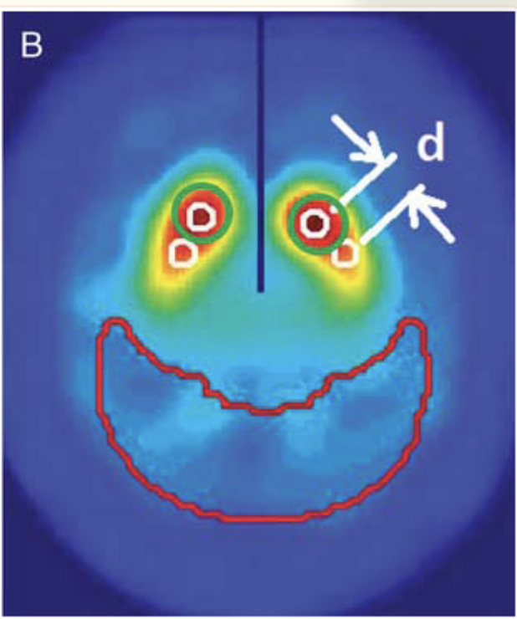
What are DaT Image Scans and how does it help with PD ?
Key Biomarkers from DaT-MRI for PD Treatment
1. DaT Binding Ratio (SBR - Specific Binding Ratio)
Measures dopamine transporter (DAT) density in the striatum. Lower SBR in the putamen and caudate nucleus is a hallmark of PD.
2. Striatal Asymmetry Index (SAI)
Measures the asymmetry between left and right striatum.
Higher asymmetry → Earlier PD detection.
3. Putamen/Caudate LoUptake Ratio
In PD, the putamen is affected earlier than the caudate.
A low putamen/caudate ratio correlates with motor impairment severity.
4. Progression Markers
Annual DaT loss rate (~5-10%) can predict disease progression.
Faster loss in the posterior putamen correlates with rapid motor decline.
Dopamine Transporter (DaT) Imaging using DaT-SPECT or DaT-MRI provides critical biomarkers for Parkinson’s Disease (PD) by assessing dopaminergic neuron loss.
When combined with other PPMI data (DTI, clinical scores, genetic markers, CSF biomarkers), it can lead to better diagnosis, progression tracking, and personalized treatment plans.

Slide 17
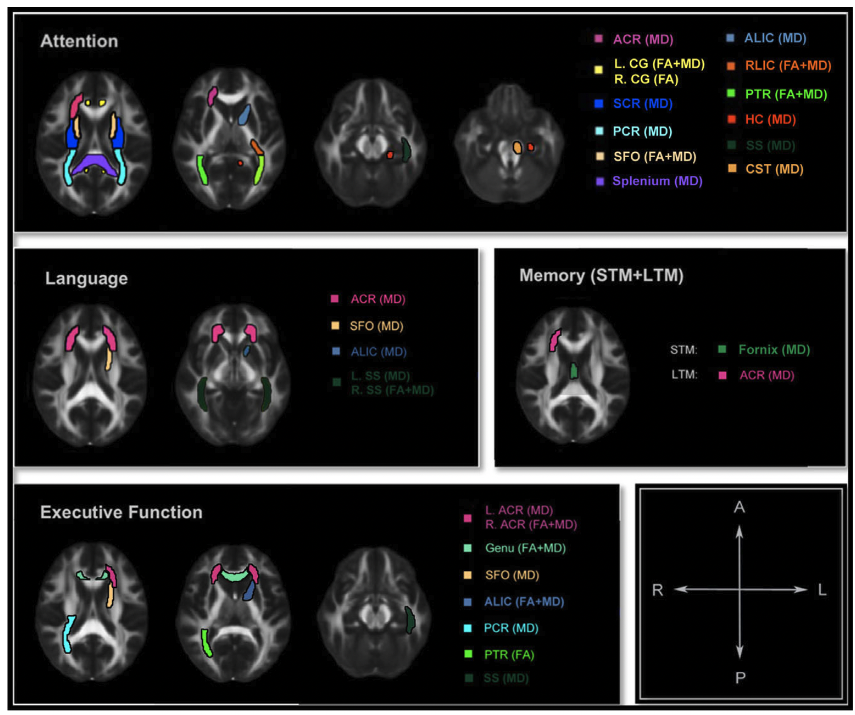
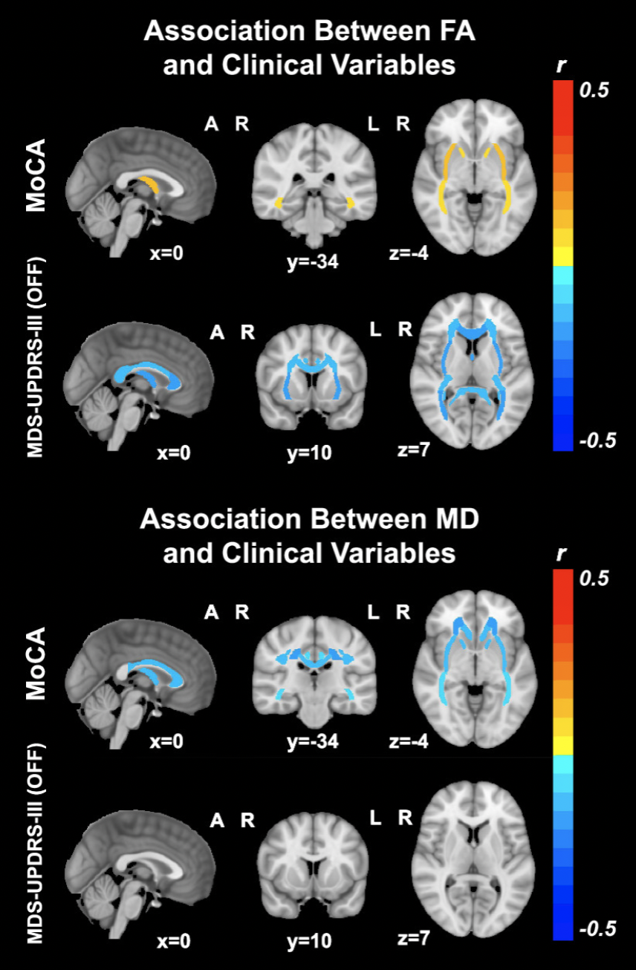
Why DTI matters !
PD progression is highly variable: Some patients experience rapid cognitive decline and early dementia, while others show slow, primarily motor symptom progression. [3]
Advanced MRI, especially diffusion imaging, reveals these individual differences: Imaging of white-matter microstructure (such as DTI) detects early and subtle brain changes linked to both motor and cognitive decline. [4][2][1]
Statistically significant ROIs in each cognitive domain overlaid on top of a standard brain in axial view [1]
Imaging biomarkers correlate with symptom severity and can predict who will decline faster: DTI metrics not only track disease stage, but can also help identify patients at highest risk for rapid deterioration. [3][2]
Without definitive clinical predictors, neuroimaging is essential: MRI biomarkers are critical for patient stratification, monitoring progression, and personalizing interventions addressing the urgent need for objective tools in this heterogeneous disease. [4]
Diffusion Tensor Imaging (DTI)
Associations between DTI measures and MoCA and MDS-UPDRS-III [3]
[1] Zheng, Zhong, et al. "DTI correlates of distinct cognitive impairments in Parkinson's disease." Human brain mapping 35.4 (2014): 1325-1333
[2] Atkinson-Clement C, Pinto S, Eusebio A, Coulon O. Diffusion tensor imaging in Parkinson's disease: Review and meta-analysis. Neuroimage Clin. 2017 Jul 15;16:98-110. doi: 10.1016/j.nicl.2017.07.011. PMID: 28765809; PMCID: PMC5527156.
[3] Owens-Walton, Conor, et al. "A worldwide study of white matter microstructural alterations in people living with Parkinson’s disease." npj Parkinson's Disease 10.1 (2024): 151.
[4] Taylor, Kirsten I., et al. "Progressive decline in gray and white matter integrity in de novo Parkinson’s disease: an analysis of longitudinal Parkinson progression markers initiative diffusion tensor imaging data." Frontiers in aging neuroscience 10 (2018): 318.
.

Slide 18
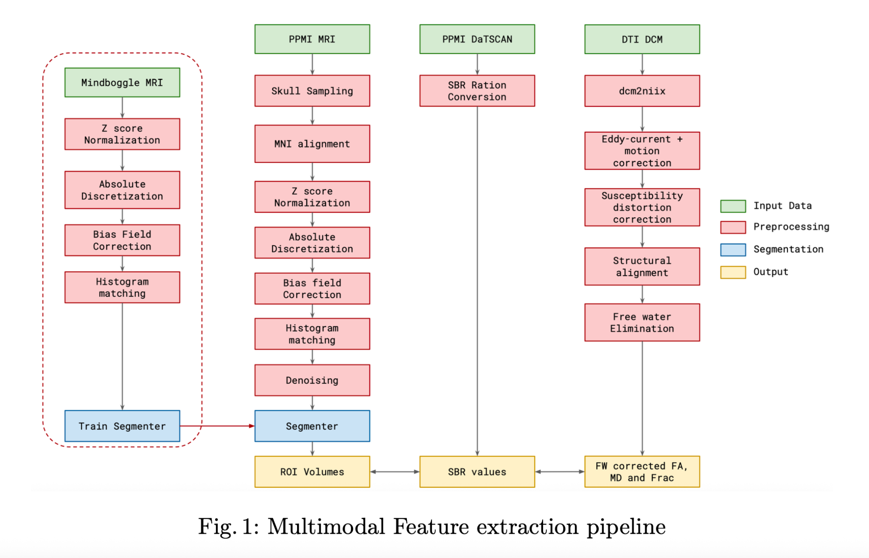
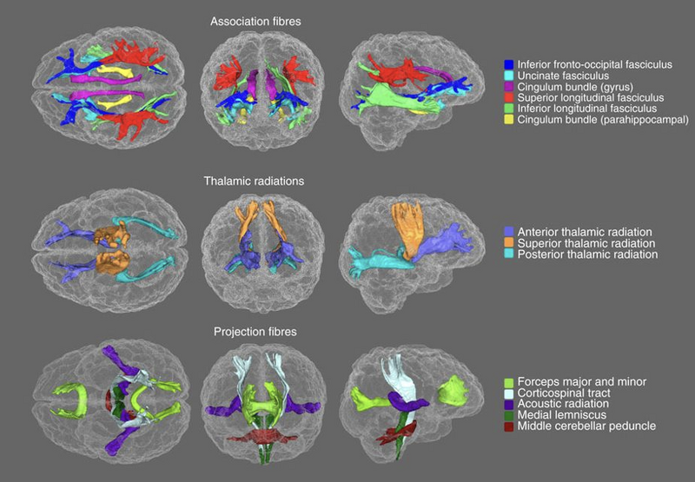
Progressive Pipeline - II : Multi-Modal Imaging (Brain Region Specificity)
Region | DTI trend | Clinical link
Substantia Nigra | ↓FA, ↑MD | Motor dysfunction
Corpus Callosum | ↓FA, ↑MD | Risk of falls
Corticospinal Tract | ↓FA | Bradykinesia & rigidity
Frontal White Matter | ↓FA, ↑MD | Executive dysfunction
Thalamic Radiation | Altered FA/MD | Sensory–motor integration
Cerebellar Peduncles | ↓FA, ↑MD | Gait & balance issues
Major white matter tracts
Utilizing Brain Region Specific T1-MRI and DAT-SPECT
Imaging Biomarkers for Enhanced Differential Diagnosis of
CSFSAA Parkinsons Positive and CSFSAA Negative -
Parkinsonisms, A. Dominick, C. Bajaj ICIBM conference,,2025
Compositional Bayesian Co-Clustering of Diffusion Tensor Imaging (DTI) Biomarkers with Clinical Measures for Enhanced Prediction of
Parkinson Disease Severity, A. Vinod C. Bajaj ICIBM conference , 2025

Slide 19
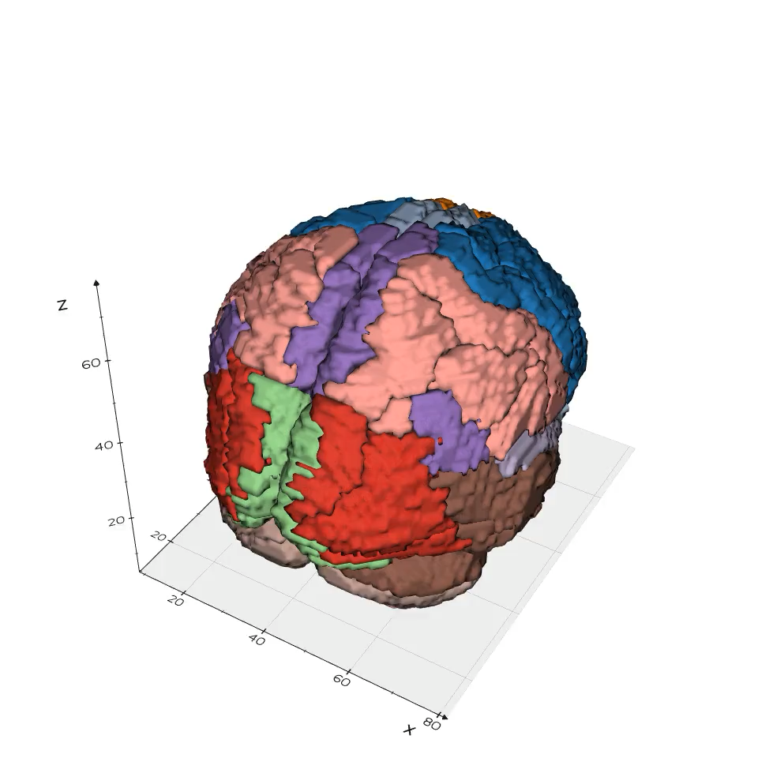
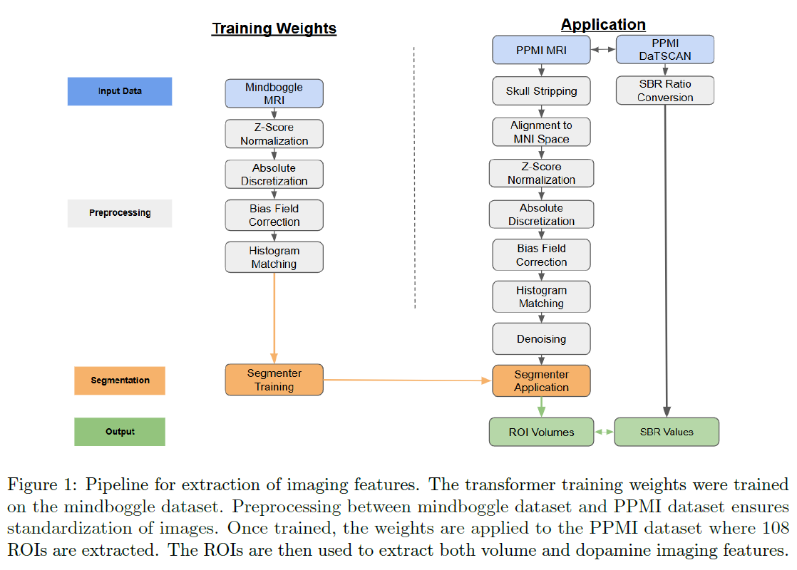
Trained/Cross-Validated SEGFORMER on MRI-T1, DAT, DTI
Segmentation Atlas (108 sub-regions)

Slide 20
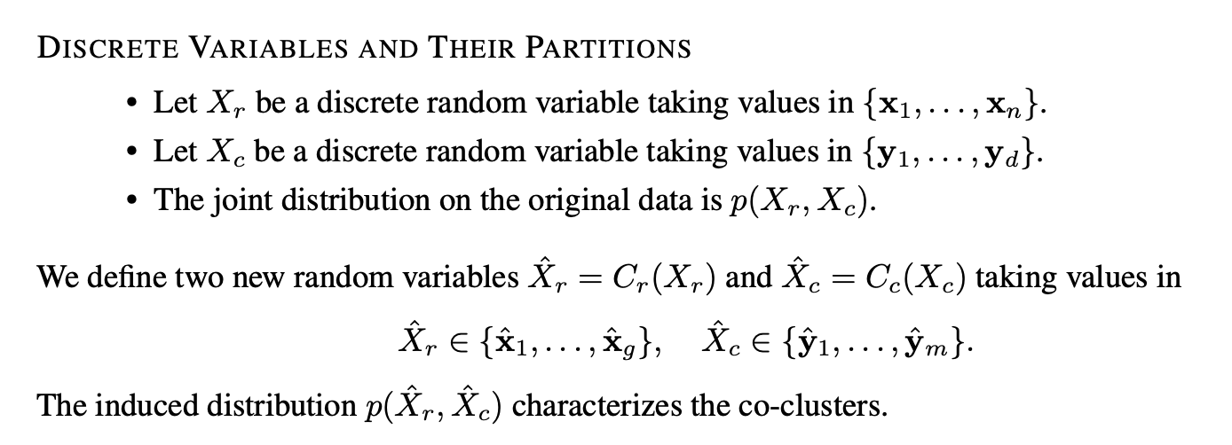
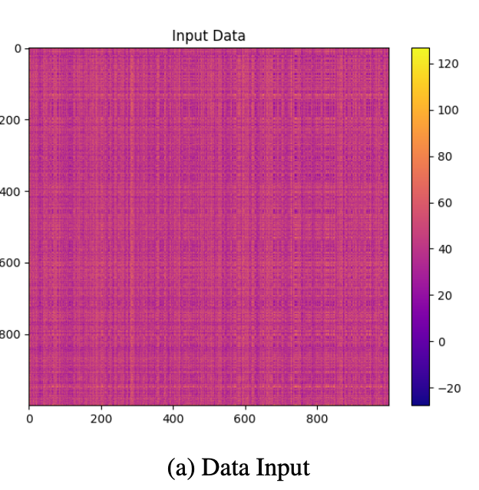
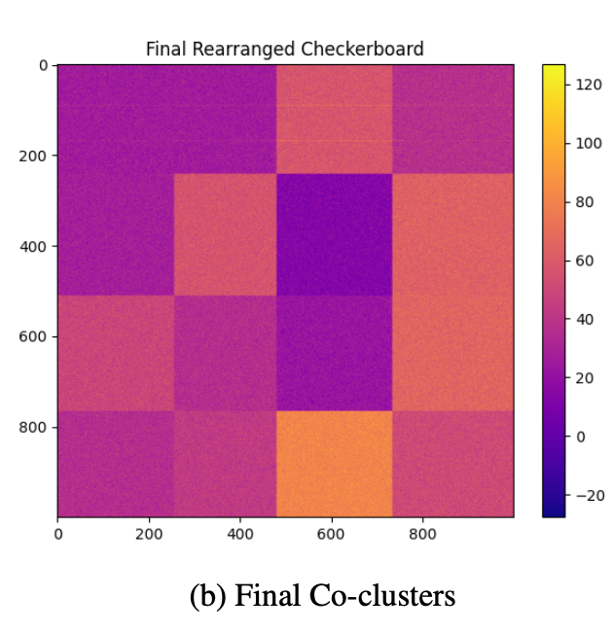
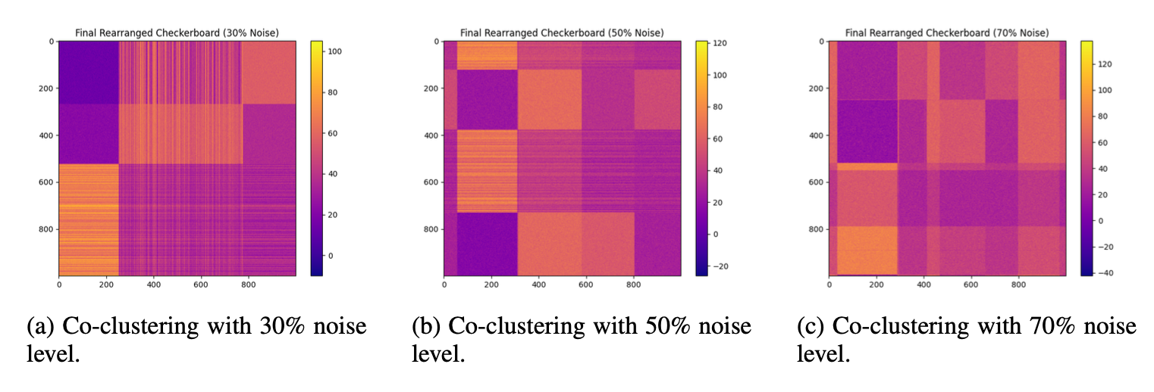
Progressive Pipeline - III : Robust Variational Bayesian Co-Clustering

Slide 21
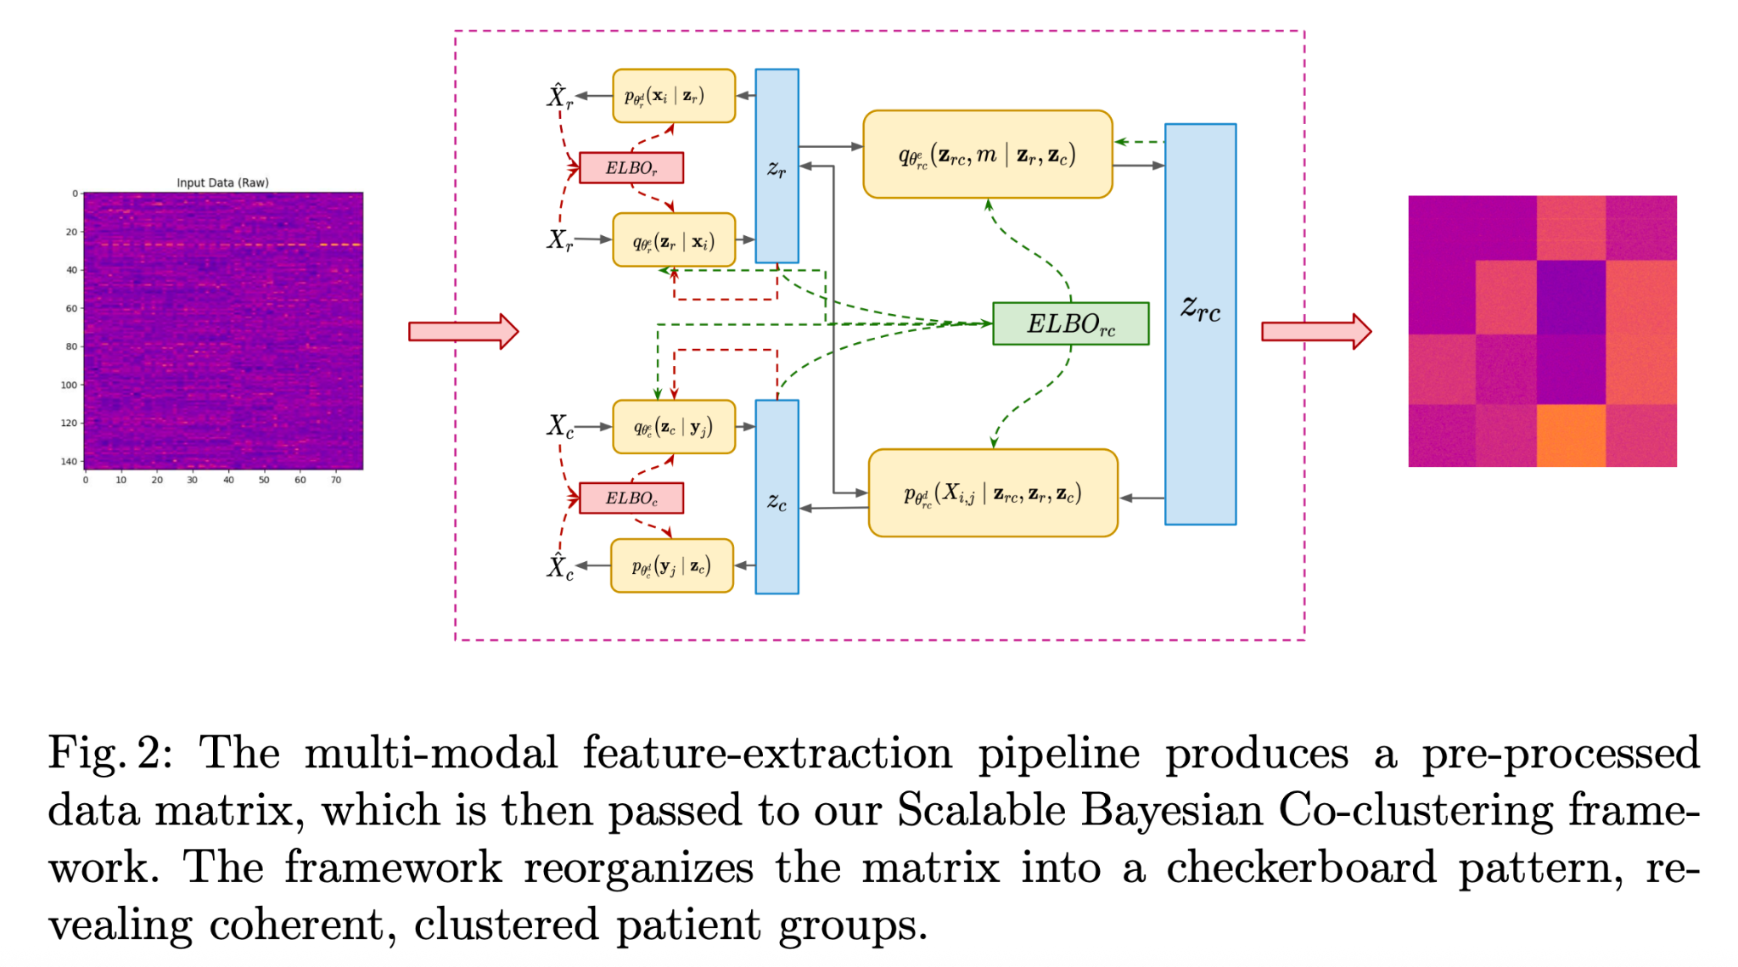
Robust Variational Bayesian Co-Clustering
Joint Clustering of Clinical & Imaging Features: Simultaneously discovers coherent patient subtypes and joint feature clusters from mixed clinical and imaging data.
Bayesian Latent Space Modeling: Embeds subjects and features into a Bayesian latent space using Gaussian mixture priors for robust, noise-tolerant clustering.
Mutual-Information Alignment: Enforces concordance between imaging and clinical clusters via mutual-information cross-loss ensuring biological and clinical interpretability.
Handles High-Dimensional, Noisy Data: Suppresses noise and prevents overfitting with KL-regularization, doubly re-parameterized gradients, and compositional loss reducing pathways.
Imaging
Imaging
Clinical
Clinical
Scalable Robust Bayesian Co-Clustering with Compositional ELBOs, A. Vinod, C. Bajaj arXiv:2504.04079v2 , 2025

Slide 22
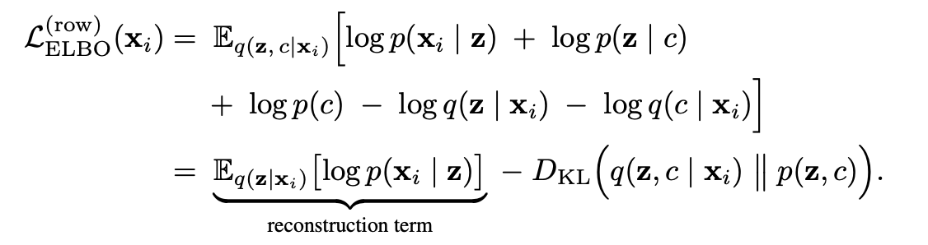
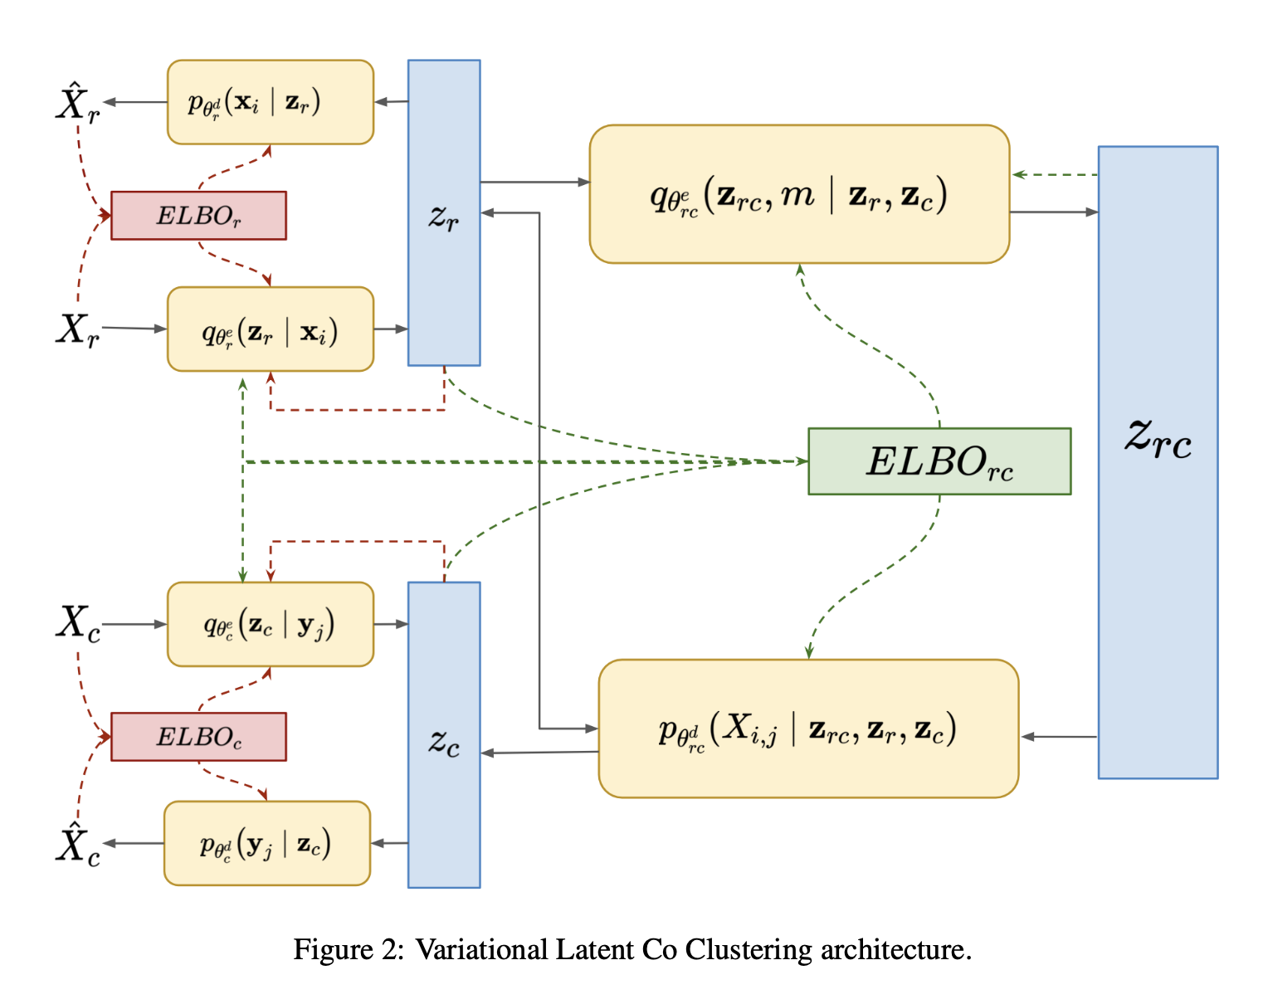
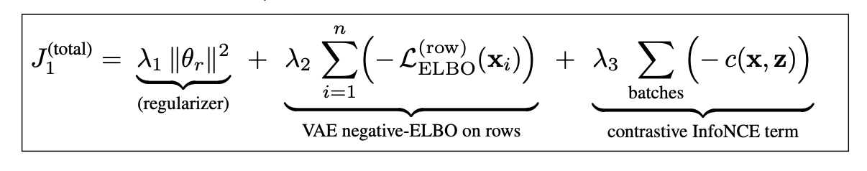
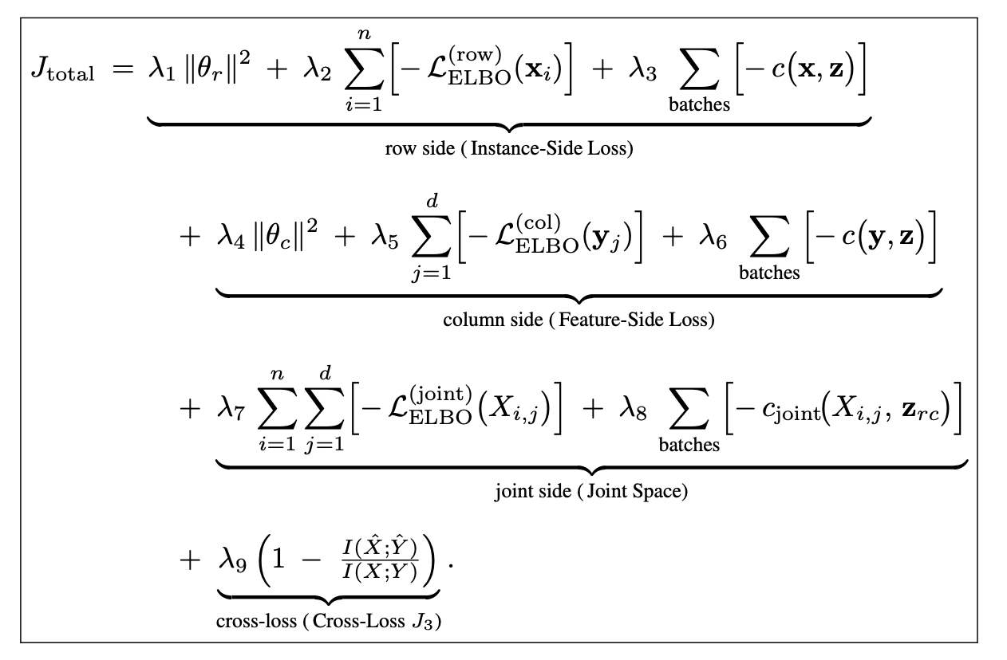
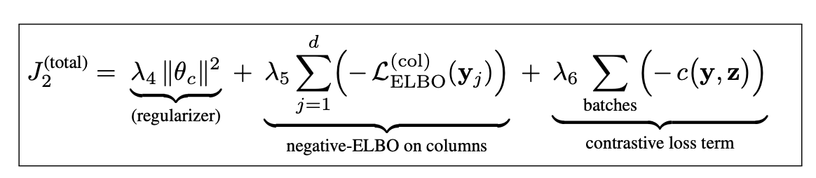
Progressive AI - IV : Co-Clustering with Compositional ELBOs

Slide 23
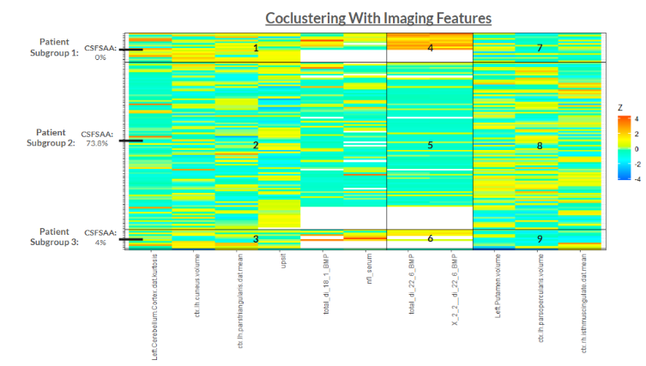
Some Differential Diagnostic Takeaways from CSFSAA + DAT Analysis
Key Imaging Features for CSFSAA
Left Cuneal Volume, Left Pars Opercularis Volume, and Left Pars Triangularis DaTSCAN mean
Clinical Impact of Co-clustering with DAT
The findings link patient subgroup 1 and 3 to an LRRK2 driven PD pathway
Both patient subgroup 1 and 3 have elevated levels of the lysosomal lipid di-22:6-BMP
Patient subgroup 1 is 100% CSFSAA negative with significantly higher percentage of LRRK2 patients at 68.7%
UPSIT was the strongest non-imaging discriminator.
This reinforces the ideas that CSFSAA positive patients have a alpha synuclein pathology that ascends via the olfactory pathway.
The findings link patient subgroup 1 to a possible amyloid beta linked pathway
significantly higher levels of amyloid beta levels at year 2 compared to the total patient population.
The findings reveal patient subgroup 3 may be more vulnerable to Levodopa-induced dyskinesias
Patient subgroup 2 has an increased pars opercularis volume while patients in subgroup 3 shows signs of decreased pars opercularis volume.
Clinical Utilization
Patients in subgroup 1 and 3 could be issued therapeutics that target the LRRK2 gene
Patients in subgroup 1 may require additional medication to combat cognitive decline.
Patients in subgroup 3 may be vulnerable to Levodopa-induced dyskinesias

Slide 24
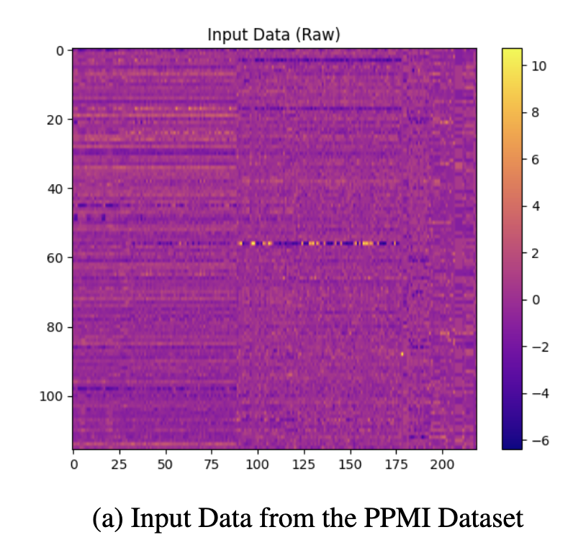
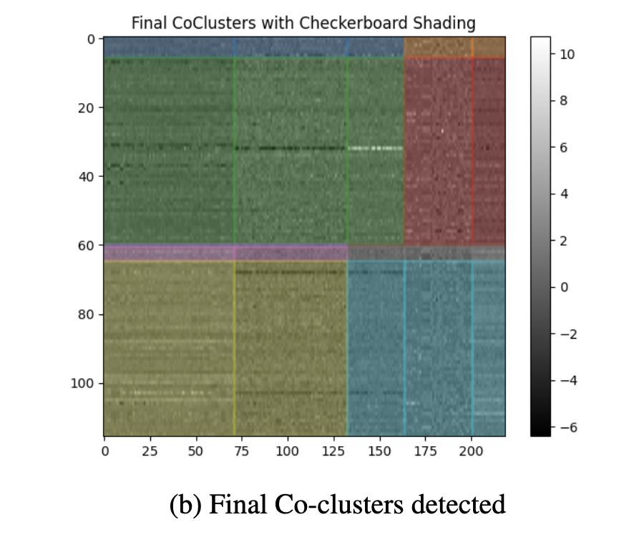
Some Differential Diagnostic Takeaways from Clinical + DTI Co-Clustering
Three Distinct Patient Subtypes Identified
Mild: Near-normal cognition (MoCA ≈ 28.5), minimal motor symptoms (UPDRS-III ≈ 10)
Moderate: Intermediate impairment (MoCA ≈ 25, UPDRS-III ≈ 20)
Severe: Pronounced cognitive decline (MoCA ≈ 22), severe motor dysfunction (UPDRS-III ≈ 30)
Imaging Metrics Mirror Clinical Severity
Thalamic Mean Diffusivity Asymmetry: Rises from 0.02 (mild) to 0.10 (severe)
Caudate FA Asymmetry: Drops from -0.01 (mild) to -0.06 (severe)
Minimal Overlap Between Subtypes: Subtypes show clear, non-overlapping ranges in both clinical and imaging features
Superior Clustering & Prediction
Our SRVCC framework outperforms spectral bi-clustering, and deep clustering baselines in both clustering purity and severity-prediction error.

Slide 25
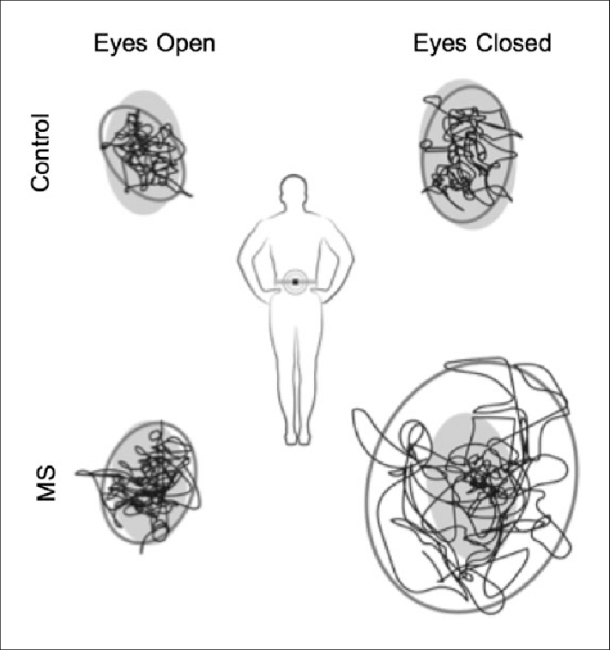
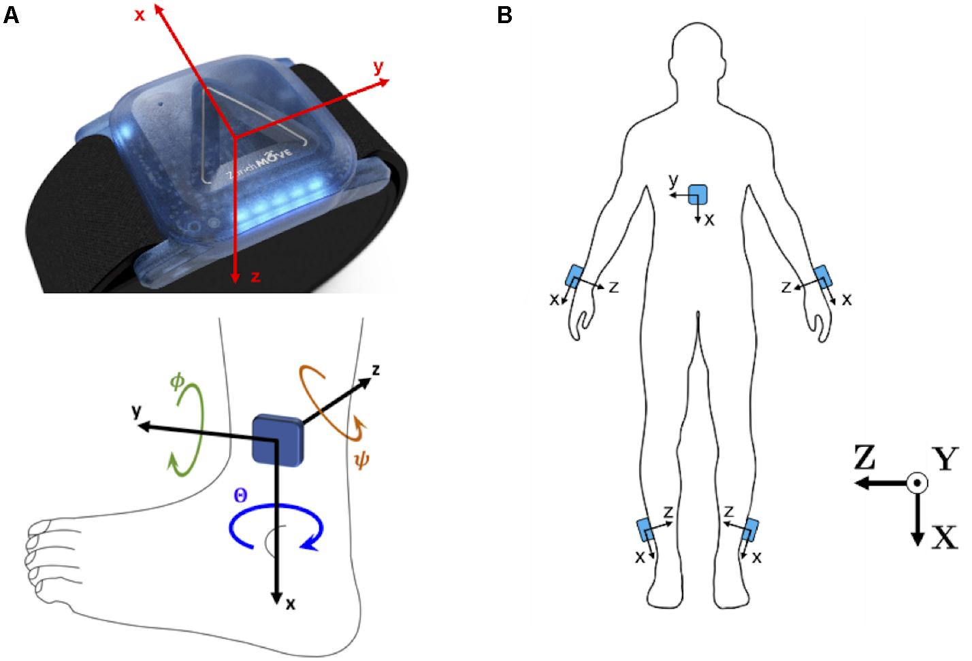
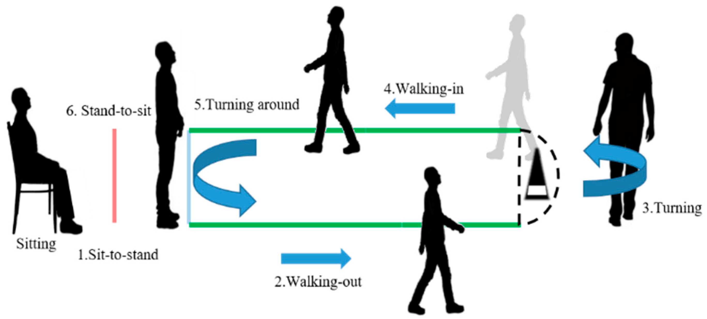
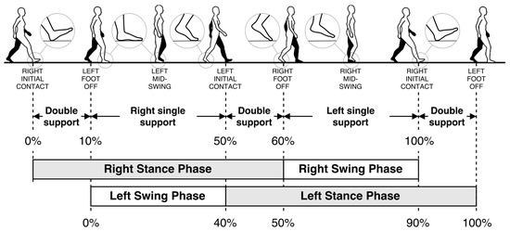
Incorporating PD Patient Gait/Arm Swing Test Data
The gait /arm swing data of patients were calculated using wireless APDM Opal IMU sensors on the lumbar spine and both wrists and feet while performing standardized tasks,
Sway Tests (Eyes Open/ Closed): Center of mass stability while standing.
Timed Up and Go (TUG): Stand-walk-turn-sit tasks to assess mobility and balance.
Usual Walk: One minute walk at preferred pace
Dual Task Walk: One-minute walk while performing serial subtractions.
Data streamed by the accelerometer, the gyroscope and the magnetometer as level 1 data:
Fig 1: OPAL Sensors
Fig 2: Sway Tests
Fig 3: TUG Task
Fig 4: Walk Task

Slide 26
Patient Gait/Arm Swing Test Databases
Gait /Arm Swing Data | BeatPD_Gait_Datasets | a data challenge focused on using wearable sensor data collected from smartphones and smart watches to predict Parkinson's disease severity. | Accelerometer (x,y,z) Gyroscope (x,y,z)
 | Synapse_Wear-Gait_PD | Wearable sensor and clinical data from Parkinson’s patients and healthy controls for gait analysis and monitoring. | Accelerometer (x,y,z) Gyroscope (x,y,z)
 | Bioclite_Restricted_Arm_Swing_Data | This dataset contains triaxial accelerometer and gyroscope data from 24 subjects performing gait activities with a smartwatch, including walking trials under varying arm-load conditions (0, 2, and 4 kg). | Accelerometer (x,y,z) Gyroscope (x,y,z)
 | Mendeley_Gait_assessment_in_Parkinson_Disease | Biomechanical and IMU data from 34 Parkinson’s patients and 8 healthy controls in a clinical gait and arm movement study. | Accelerometer (x,y,z) Gyroscope (x,y,z)
 | PPMI_Gait_Data_selected | Binary and ordinal labels of key Parkinsonian motor symptoms across longitudinal visits for modeling, subtyping, and progression analysis. | Level 2 Features

Slide 27
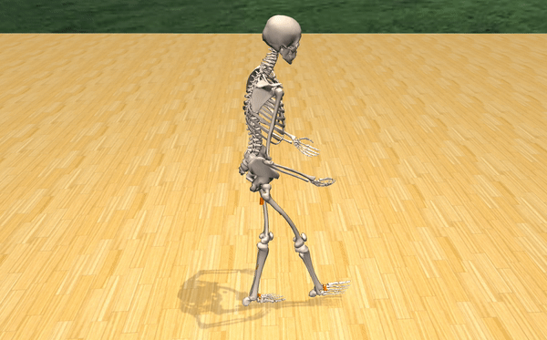
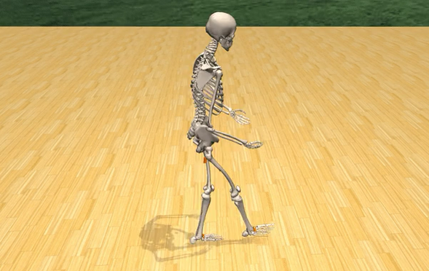
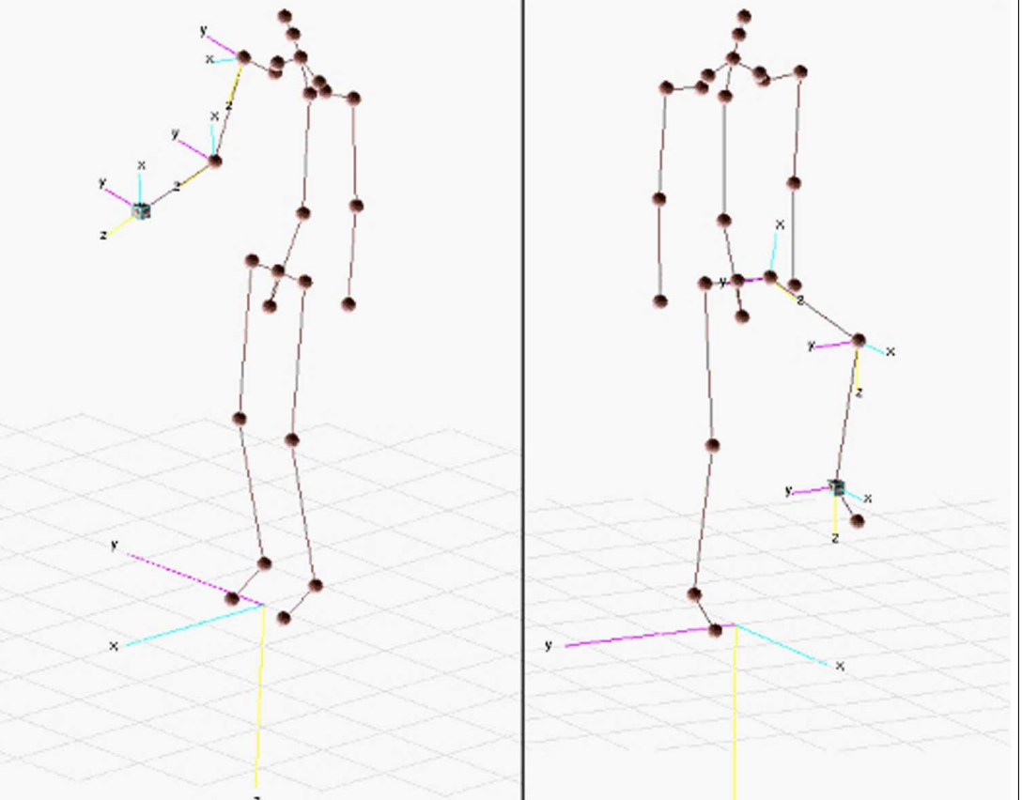


PD Patient Gait/Arm Swing (Inverse Kinematics)
https://simtk.org/

Slide 28

How to Encapsulate in Multi Scale Latent Space

Slide 29
Robust MIMO Transformations from Level 1 from Level 2 Time Series (Stochastic Processes) — Motion Code
Level 2 Feature | Computation from Level 1 Feature
Amplitude | Peak-to-peak angular range from wrist and trunk sensors using Euler angles
Velocity / Speed | Speed from 10m walk; cadence from step count per minute
Timing | Time from TUG; stride time from vertical acceleration
Variability | Standard deviation and coefficient of variation of amplitude and stride time
Symmetry | Ratios and asymmetry indices from bilateral sensors
Smoothness / Jerk | Time derivative of acceleration
Regularity | Autocorrelation of vertical acceleration
Postural Sway (Balance) | Derived from accelerometer data from lumbar sensor during 30 second stance
Step Count | Counted from vertical acceleration peaks
Prior Work: algorithms given in [1] and [2]…however not robust to very noisy data.
[1] Warmerdam, E., Romijnders, R., Welzel, J., Hansen, C., Schmidt, G., & Maetzler, W. (2020). Quantification of Arm Swing during Walking in Healthy Adults and Parkinson’s Disease Patients: Wearable Sensor-Based Algorithm Development and Validation. Sensors, 20(20), 5963. https://doi.org/10.3390/s20205963
[2] Luis Pastor Sánchez-Fernández, Luis Alejandro Sánchez-Pérez, Juan Manuel Martínez-Hernández, Computer model for gait assessments in Parkinson's patients using a fuzzy inference model and inertial sensors, Artificial Intelligence in Medicine, Volume 160, 2025, 103059, ISSN 0933-3657, https://doi.org/10.1016/j.artmed.2024.103059. (https://www.sciencedirect.com/science/article/pii/S0933365724003014)

Slide 30
Robust MIMO Transformations from Level 2 from Level 3 Time Series (Stochastic Processes) - Motion Code
Level 3 Feature | Level 2 Features
Bradykinesia. (Slowness of Movement) | Speed of Gait<1m/s; Cadence<90 steps/min; Stride time < 1.3 sec [1]
Hypokinesia (Reductio of Amplitude) | Right and Left Arm amplitude <20° peak to peak angular displacement [2]
Asymmetry (Noticeable difference in severity of symptoms (tremor, rigidity, between left and right | ASA_U>20% difference between limbs; SYM_U<0.8(ratio of weaker to stronger limb) [3]
Dyscoordination (inability to execute movements smoothly efficiently) | STEP_SYM_U<0.8; TRA_U>0.5 [4]
Smoothness Loss | R_JERK_U,L_JERK_U>1.5 normalized jerk units [5]
Gait Variability | STR_CV_U>3 coefficient of variation, STEP_REG_U<0.7 autocorrelation [6]
Postural instability | SW_VEL_OP >0.8m/s ; SW_PATH_OP > 100 cm during 30 second stance [7]
[1] Washabaugh et al. 2017: https://pubmed.ncbi.nlm.nih.gov/28433867/
[2] Warmerdam et al. 2020: https://www.mdpi.com/1424-8220/20/20/5963
[3] Lewek et al. 2009: https://e-learning.kku.ac.th/file.php/2024/current_topics/Arm_swing_in_PD.pdf
[4] Roemmich et al. 2012: https://pmc.ncbi.nlm.nih.gov/articles/PMC3552037/
[5] Kuhner et al. 2020: https://pmc.ncbi.nlm.nih.gov/articles/PMC7020741/
[6] Washabaugh et al. 2017: https://pubmed.ncbi.nlm.nih.gov/28433867/
[7] Horak 2006: https://pubmed.ncbi.nlm.nih.gov/16926210/

Slide 31


Differential Diagnosis on PPMI Gait/Arm Swing data

Slide 32


Slide 33


Slide 34





RobustTime Series Multi-Input Multi-Output (MIMO) Transformer
M. Nguyen, C.Bajaj “Motion Code: Robust Time series Classification and Forecasting via Sparse Variational Multi-Stochastic Processes Learning,”
arXiv:2402.14081, 2024

Slide 35




MIMO-Variational Inference with Motion Code
Claim 2
Claim 1

Slide 36





Robust Filtered Separation of a Mixture of Multi-Channel Noisy Time Series
Motion Code
M. Nguyen, C.Bajaj “Motion Code: Robust Time series Classification and Forecasting via Sparse Variational Multi-Stochastic Processes Learning,”
arXiv:2402.14081, 2024

Slide 37







Robust Filtered Separation and Imputation of a Mixture of Multi-Channel Noisy Time Series
Motion Code
Motion Code Forecasting
M. Nguyen, C.Bajaj “Motion Code: Robust Time series Classification and Forecasting via Sparse Variational Multi-Stochastic Processes Learning,”
arXiv:2402.14081, 2024

Slide 38
PD_Beat Dream Challenge
Dataset | Train | Test | Length | Description
CIS-PD 1 | 20 | 322 | 257-1665 | Parkinson’s disease sensor data focusing on understanding recovery stage
CIS-PD 2 | 24 | 429 | 208-1665 | Parkinson’s disease sensor data focusing on detecting tremor patterns
Parkinson’s Disease Sensor Data: The Parkinson data are derived from the Clinician Input Study (CIS-PD) [1, 2], a 6-month project using Apple Watch devices to monitor patients during clinic visits and at home.
For two days before each clinic visit, patients reported symptoms every 30 minutes, focusing on medication state and tremor severity. The accelerometer data was segmented into 20-minute intervals.
The above Parkinson data were obtained from the Biomarker & Endpoint Assessment to Track Parkinson’s
disease DREAM Challenge.
https://www.synapse.org/Synapse:syn20825169/wiki/600898.
During data processing, all personal identifying information (PII) has been thoroughly removed
from the dataset to ensure privacy and data security.

Slide 39



Application of Motion Code (1/3)
The important timestamps of Motion Code captures a skeletal approximation of the underlying stochastic process even though the individual realizations deviates from the mean process.
Allows us to visualize the global features of the underlying dynamics which might not evident at first glance.
Fig1: Interpretable Features Showing Tremor Patterns And Disease Stages For Parkinson Data

Slide 40


Application of Motion Code (2/3)
Motion code can handle timeseries data with different/missing timestamps due to its ability to learn the underlying dynamics using important timestamps.
For Parkinson’s dataset (PD), Motion Code efficiently handles out-of-sync timestamps and missing values.
PD time series of wearable sensors vary in length from 200 to 1660 points. Traditional techniques interpolate data, which causes distortion. Motion code circumvents it, thereby preserving data integrity.
Fig2: Motion Code Handling missing data in PD smartphone accelerometer sensor data

Slide 41




Application of Motion Code (3/3)
Motion Code employs a multi-stochastic process learning approach across multiple time series, enabling it to capture relationships and patterns that might be missed by algorithms that analyze individual series in isolation.

Slide 42
ActionIntel@PD: A Patient Inference and Visualization Tool
Switch to Live Demo
http://127.0.0.1:8050/

Slide 43

ActionIntel: Inference and Visualization Tool

Slide 44

Ability to choose specific patient

Slide 45

See how patient does on different standardized motor assessments
Gait/Walking Test: How a person walks
Tug Test: Time it takes a person to perform a sequence of actions
Postural Sway/Balance: Measures person’s ability to maintain balance while standing still
Free Motion: Visualization movement patterns that don't’ fit into a standardized test

Slide 46

Control animation speed

Slide 47

Choose different measurements on x-axis
UPDRS-III Motor Score: Standard clinical score to rate severity of patient’s motor symptoms
Objective Motor Impairment: Score calculated from sensor data of overall motor function
Gait Speed (m/s): Patient’s walking speed
Arm Swing Asymmetry: Difference in swing between left and right arm during walking
Digital Sensor Response (Mean): Patient’s average performance across all fine-motor tasks

Slide 48

Choose different measurements on y-axis
Movement Quality Index: Score to represent smoothness, control, and efficiency of patient’s movements
Objective Motor Impairment: Score calculated from sensor data of overall motor function
Gait Speed (m/s): Patient’s walking speed
Bilateral Coordination Score: Score measures how well the left and right sides of body work together during movements
Sensor-Clinical Correlation: Score to evaluate how closely the objective sensor data aligns with UPDRS score

Slide 49

Measures asymmetry in arm swing
Dashed Line shows perfect symmetry

Slide 50
Chart visualizes one full walking cycle
X-Axis: Represents phase of gait cycle, measured in radians
Y-Axis: Shows Amplitude, which is the forward and backward position of the arms

Slide 51
Visualizes three different aspects of movement:
Coordination: How well patient’s limbs move together in a synchronized way
Movement Quality: Represents smoothness and control of patient’s movements
Symmetry: Measures balance between left and right sides of the body

Slide 52
Control Animations

Slide 53

Demonstration of Patient with Low PD (2)
Gait Speed: 0.97 m/s
Arm Swing asymmetry: 23.303

Slide 54

Demonstration of Patient with Severe PD (44 & 58)
Gait Speed: 0.65 m/s
Arm Asymmetry: 14.734

Slide 55
Differential Diagnosis using Gait/Arm Swing Tests:
PD vs. Functional Parkinsonism: Observing passive arm swing and arm swing during walking/running can help differentiate functional Parkinsonism from PD. In functional Parkinsonism, passive arm swing may be normal even with marked asymmetry during walking/running, while it typically remains reduced in PD.
PD vs. Atypical Parkinsonism: Arm swing asymmetry is a distinct characteristic of early PD, while atypical parkinsonisms are usually associated with a more symmetrical pattern.
PD vs. Other Neurological Conditions: Some non-neurological conditions, like frozen shoulder syndrome, can also cause unilaterally reduced arm swing, necessitating a thorough evaluation for accurate diagnosis.
Monitoring and Progression: Quantifying arm swing, especially using wearable sensors, can monitor the response to dopaminergic medication and potentially track disease progression in PD. Changes in arm swing, like decreased elbow amplitude, may even predict disease progression in conditions like multiple sclerosis.
Limitations: In-clinic assessments can be subjective and may not accurately reflect daily life function. While wearable sensors offer continuous and objective data collection, accurately detecting and filtering out other arm activities during gait in free-living conditions remains a challenge.

Slide 56
Challenges & Way Forward
While multi-modality differential diagnosis and individualized interventions offer significant promise, several challenges remain:
I. Validation and Standardization: Validating diagnostic tools and ensuring consistent results across different research centers is crucial for widespread clinical application.
II. Data Standardization and Regulatory Hurdles: Standardizing data across diverse populations and addressing regulatory concerns regarding data usage are essential for integrating AI into clinical practice.
III. Cost and Accessibility: Some diagnostic and treatment options can be expensive and require specialized expertise, limiting accessibility for many patients.
Despite these challenges, the continued development of Progressive AI and advancements in understanding the multifaceted nature of Parkinson's disease hold immense potential for revolutionizing precision individualized diagnosis and treatment.

Slide 57
Acknowledgement
The research is supported in part by the Michael J. Fox Foundation, the Peter O’ Donnell Foundation, and gifts from Jim Holland - Backcountry, and Michael-Connie Rasor Foundation.
We additionally and sincerely thank
Conor Fearon, MD, Phd, Neurologist at Mater Misericordiae University Hospital, Dublin, Ireland,
Dr. Barbara Marebwa, Senior Scientist, Manager at the Michael J. Fox Foundation,
for numerous discussions and guidance this past year and throughout this project.

Slide 58

The Knowledge of Genes implicated in Parkinsons Disease ?
SNCA—This gene, which makes the protein alpha-synuclein, was the first gene identified rolhat Lewy bodies seen in all cases of PD contain clumps of abnormal alpha-synuclein. This discovery revealed the link between hereditary and sporadic forms of the disease.
LRRK2—LRRK2 codes for a complex protein called dardarin that plays a role in many cellular functions, causing aggregation of Lewy bodies.
DJ-1—This gene helps protect cells from oxidative stress, and mutations in this gene can cause rare, early-onset forms of PD.
PRKN (Parkin)—The parkin gene makes a protein that helps cells break down and recycle proteins. Mutations in this gene can cause early-onset PD.
PINK1—PINK1 codes for a protein active in mitochondria. Mutations in this gene appear to increase susceptibility to cellular stress.
GBA (glucocerebrosidase-beta)—Mutations in GBA cause Gaucher disease, a type of lipid storage disorder.
component of the retromer complex are associated with late-onset PD266,267, with D620N being the only mutation characterized to date268,269. Mutations in the PARK7 gene, which encodes DJ1, cause autosomal-recessive PD270. DJ1 is a multifunctional redox-sensitive protein that may mediate neuroprotection by dampening mitochondrial oxidative stress271 and regulating anti-apoptotic and anti-oxidative gene expression272,273.
BST1, SYT11, TMEM175 and GRN
Genome-wide association studies have linked several further candidate genes with PD risk, with several of these genes related to the immune system. The immune-associated gene BST1 has been proposed to play a role in neutrophil adhesion and migration and may cause selective vulnerability of dopaminergic neurons in PD274. Synaptotagmin 11, encoded by SYT11, localizes to the trans-Golgi network and recycling endosomes and is involved in cytokine secretion and phagocytosis in microglia275. TMEM175 encodes a lysosomal K+ channel that stabilizes lysosomal pH and regulates lysosome catalytic activity52,276. The GRN gene encodes progranulin (PGRN), the precursor to granulins, which possess cytokine-like activity and regulate cellular proliferation, growth and tumorigenicity.
Notes:
The GBA gene encodes for the lysosomal enzyme glucocerebrosidase that mediates conversion of glucocerebroside to glucose and ceramide. Heterozygous GBA mutation carriers have an increased risk of developing PD254; GBA mutations are now identified as the most common genetic risk factor for PD255. The PRKN and PINK1 genes are two of the most well-characterized autosomal recessive genes associated with PD256,257. Five missense point mutations, A30P258, E46K259, H50Q260, G51D261 and A53T262, in the α-synuclein encoding gene SNCA may cause autosomal dominant PD. Moreover, duplication and triplication of the α-synuclein gene locus has been described in familial and sporadic PD263 and in dementia with Lewy bodies125,255,264,265. Heterozygous changes in the gene encoding the VPS35 cargo-binding

